Slide 1

Course Behavioral Economics
Academic year 2013-2014 Alessandro Innocenti
Lecture 1 Laboratory Methods
Lecture 1 What is an experiment?
Aim: To run an experiment and to provide a basic introduction to laboratory methodology.
Outline: Participation in an experiment run by the instructor. Experimental purposes (Why?). Experimental Methods (How?). Experimental Subjects (Who?). Experimental Topics (What?).
Readings:
Smith, V. (1976) “Experimental Economics: Induced Value Theory”, The American Economic Review, 66, 274-279.
Smith, V. (1994) “Economics in the Laboratory”, Journal of Economic Perspectives, 8, 113-131.
Croson, R. (2005) “The Method of Experimental Economics”, International Negotiation, 10, 131-148.
Blogs, Videos and Websites:
Veconlab Experimental Economic Laboratory
http://veconlab.econ.virginia.edu/admin.htm

Slide 2


Slide 3
Lecture 1 Laboratory methods
POINTS OF VIEW
PROS
“Would it not be better to leave laboratory experiments to psychologists who are trained to run them properly? Nobody doubts that we have a great deal to learn from psychologists about laboratory technique and learning theory, but recent history would nevertheless suggest that the answer is a resounding no. Our comparative advantage as economists is that we not only understand the formal statements of economic theory, but we are also sensitive to the economic environments and institutions within which the assumptions from which such statements are deduced are likely to be valid. Just as chemists know not to mix reagents in dirty test tubes, so we know that there is no point in testing economic propositions in circumstances to which they should not reasonably be expected to apply.”
(Binmore 1999)
“Once models, as opposed to economies, became the focus of research the simplicity of an experiment and perhaps even the absence of features of more complicated economies became an asset. The experiment should be judged by the lessons it teaches about theory and not by its similarity with what nature might happen to have created.”
(Plott 1991)

Slide 4
POINTS OF VIEW
CONS
The laboratory is not a socially neutral context, but is itself an institution with its own formal or informal, explicit or tacit, rules
Human agency takes place within a socio-economic world that is structured in the sense that it consists of internally-related positions and systems
Experimentation in economics is likely to be of limited value, save for situations – such as auctions – that exist in conditions of relative isolation and are characterized by low internal complexity
(Siakantaris 2000)
experimental situations often project a game-like atmosphere in which a ‘subject’ may see himself as ‘matching wits’ against the experimenter
experimental subjects are cast in roles and they can act in accordance with his (mis)perceptions of these roles
experiments have too short horizons (real world lasts many years and many trials)
human beings are capable to control their behavior through the implementation of abstract rules
(Cross 1994)

Slide 6
PURPOSES OF EXPERIMENTS (WHY?)
1) Test of Behavioral Hypotheses.
by constructing a laboratory environment that satisfies as many of the structural assumptions of a particular theory, it is possible to verify its behavioral implications
2) Theory Stress Tests
to examine the sensitivity of a theory to violations of obviously unrealistic assumptions
3) Searching for Empirical Regularities
heuristic experiments to discover and document stylized facts
(Davis-Holt, Experimental Economics 1994)
a) Speaking to Theorists
b) Searching for Facts
c) Whispering in the Ears of Princes
(Roth 1986)

Slide 7
EXPERIMENTAL METHODOLOGY (HOW?)
1. PROCEDURAL REGULARITY
to permit replications that the researcher and observers would accept as being valid
- instructions
- subject pool and methods of recruiting subjects
- experimental physical environment
- computerized or manual
2. MOTIVATION
- Induced-value theory: use of a reward medium allows to induce pre-specified characteristics in experimental subjects and to make subjects’ innate characteristics largely irrelevant
- monotonicity: subjects prefer more reward medium to less and not become satiated
- salience: rewards are explicitly and unambiguously connected to the decisions made
- dominance: changes in subjects’ utility from the experiment come mainly from the reward medium and other subjective costs or benefits are rendered negligible by comparison, i.e. others’ reward

Slide 8
3. UNBIASEDNESS
Experiments should be conducted in a manner that does not lead participants to perceive any particular behavioral pattern as being correct or expected, unless explicit suggestion is a treatment variable - double blind setting
4. CALIBRATION
The design has to pre-specify and to cleanly separate the experimental predictions of alternative theories.
5. DESIGN PARALLELISM
Results established in the lab hold in other, especially non-lab, real-world situations where similar ceteris paribus conditions hold
Vernon Smith’s parallelism precept (1982): “Propositions about the behavior of individuals and the performance of institutions that have been tested in laboratory microeconomics apply also to non-laboratory micro economies where similar ceteris paribus conditions hold”
Charles Plott (1982): “While laboratory processes are simple in comparison to naturally occurring processes, they are real processes in the sense that real people participate for real and substantial profits and follow real rules in doing so. It is precisely because they are real they are interesting”

Slide 9
PROFESSIONAL SUBJECTS, STUDENTS or WHAT?
Main Subjects pool - Undergraduate students
readily accessible
low opportunity costs
steep learning curve
they do not know much about experimenter’s hypothesis
PhD students
unreliable subjects because they get interested in what are you doing and respond to their understanding of your topic rather than to incentives you have constructed
Classes or friends
dominance or salience at risk, conflicts between personal, teaching and scientific aims

Slide 10
Professional subjects
comparisons show that students are more adept at maximizing their profits and learning in the lab
high opportunity costs
pre-specified and innate characteristics are too strong
when involved in laboratory markets they attempt to apply rules of thumb, which, valuable for dealing with uncertainty in the parallel natural market, are meaningless guides in the lab.
Controversial evidence
Burns (1985): professional wool buyers and students in a progressive auction (professionals apply familiar rules and not adjust to design requirements)
Dyer, Kagel, and Levin (1985): bidding behavior of students and construction workers (no difference)
Dejong et al (1988): Businessmen and students in sealed-offer markets (same profits, but higher variance for businessmen)
What about gender, age, risk attitude, experience?

Slide 11
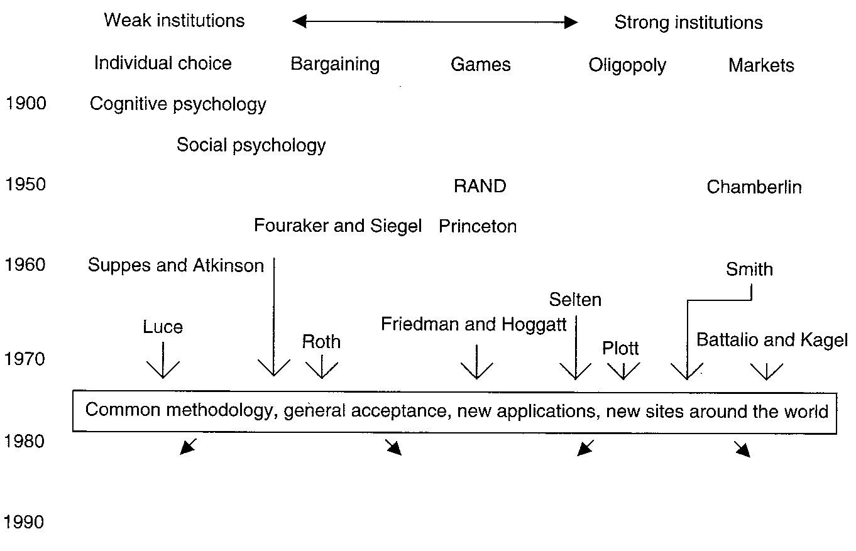

Slide 12
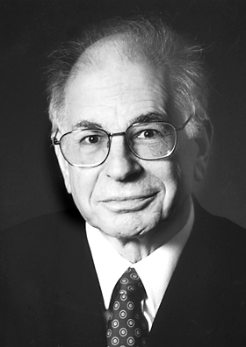
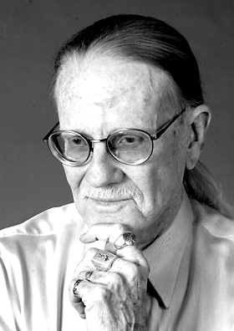

Nobel Prize in Economics 2002

Slide 13
Kagel, John H. - Roth, Alvin E.
The Handbook of Experimental Economics
INDEX
a) public goods
cooperation vs. selfishness (social dilemmas, free-riding, institutions)
what improves cooperation (thresholds, learning)
b) coordination problems
experiments with overlapping generations
coordination games with Pareto ranked equilibria
decentralized matching environments
c) bargaining experiments
agreements
causes of disagreements and costly delays
bargaining protocol and preplay communications

Slide 14
d) industrial organization
trading institutions centralized and decentralized
monopoly regulation and potential entry
market structure and market power
collusion factors
product differentiation and multiple markets
e) experimental asset markets
informational efficiency of markets
state-contingent claims and bubbles
learning and dynamics of adjustment paths
investment and public policy
f) auctions
symmetric independent private-values models
common value auctions
collusion
g) individual choice behavior

Slide 15
individual Choice Behavior
Judgment
A. Calibration
  1. Scoring Rules
  2. Confidence Intervals
B. Perception and Memory Biases
C. Bayesian Updating and Representativeness
  1. Underweighting on Likelihood Information (Conservatism)
  2. The Law of Small Numbers and Misperceptions of Randomness
D. Confirmation Bias and Obstacles to Learning
E. Expectations Formation
F. Iterated Expectations and the Curse of Knowledge
  1. False Consensus and Hindsight Bias
  2. Curse of Knowledge
G. The Illusion of Control

Slide 16
II. Choice under Risk and Uncertainty
A. Mounting Evidence of Expected Utility Violation (1965-1986)
  1. The Allais Paradoxes
  2. Process Violations
  3. Prospect Theory
  4. Elicitation Biases
B. Generalizations of Expected Utility and Recent Tests
  1. Predictions of Generalized EU Theories
  2. Empirical Studies Using Pair-wise Choices
  3. Empirical Studies Measuring Indifference Curves
  4. Empirical Studies Fitting Functions to Individuals
  5. Cross-Species Robustness: Experiments with Animals
C. Subjective Expected Utility
  1. The Ellsberg Paradox
  2. Conceptions of Ambiguity
D. Choice over Time

Slide 17
II. Choice under Risk and Uncertainty / II
E. Description Invariance
  1. Framing Effects
  2. Lottery Correlation, Regret, and Display Effects
  3. Compound Lottery Reduction
F. Procedure Invariance
  1. New Evidence of Preference Reversal
  2. Arbitrage and Incentives
  3. Reversals and Markets
  4. Social Comparisons and Reversals
G. Endowment Effects and Buying-Selling Price Gaps
  1. Market Experiments
  2. Endowment Effects: Some Psychology and Implications
K. Search
  1. Search for Wages and Prices
  2. Search for Information

