Slide 1

Alessandro Innocenti
Anno Accademico 2014-2015
Corso Marketing
Lecture 4 DECISIONS AND and risk
Aim: To analyze how economic agents draw conclusions and take decisions in risky environments.
Outline: WYSIATI (What you see is all there is). Substitution. The halo effect. The affect heuristic. Risk-as-feelings hypothesis.
Readings:
Kahneman, D. (2011) Thinking, Fast and Slow, Farrar, Straus and Giroux, New York, chapt. 7-8-9-13.
Slovic, P., M. L. Finucane, E. Peters, and D. G. MacGregor (2004) “Risk as Analysis and Risk as Feelings: Some Thoughts about Affect, Reason, Risk and Rationality“, Risk Analysis, 24, 311-322.
Blogs, Videos and Websites:
Paul Slovic, A Walk through Risk
http://www.youtube.com/watch?v=A_-9d-ihXGU&list=PL72332D44DB283F87&index=1 (Part 1 13:30)
http://www.youtube.com/watch?v=hnH5KzxT1C8 (Part 2 11:53)

Slide 2
WYSIATI
WHAT YOU SEE IS ALL THERE IS
In addition to making sense out of the events unfolding before it, System 1 is also involved in judging and evaluating the phenomenon it experiences.
System 1 must resort to shortcuts and educated guesses to render its impressions as quickly as possible.
Essentially, what system 1 does is that it jumps to conclusions based on what limited information it has access to which information (given that it lives very much in the moment) is confined to what is directly in front of it, and/or most readily comes to mind
“WYSIATI: what you see is all there is” is System 1’s tendency to consider only the information that is directly at hand

Slide 3
an example
Example of WYSIATI Q. “Will Mindik be a good leader? She is intelligent and strong…”
Your first impression here is probably to answer the question in the affirmative
Intelligence and strength both seem to be important qualities to have in a good leader, and “this is the best story that can be constructed from two adjectives”
In other words, given the information we have, this is the most accurate conclusion we can come up with.
But we have not bothered to ask “‘what would I need to know before I formed an opinion about the quality of someone’s leadership?’”
This is simply not System 1’s department.

Slide 4
SUBSTITUTION
In addition to WYSIATI, System 1 also jumps to judgments and evaluations through substitution.
When presented with a question that it does not know the answer to, System 1 activates and answer a related but much easier question and then offer up this answer to System 2 as the solution to the more difficult question
if you are asked an opinion about the worthiness of buying Ford shares, and you do not have much knowledge about said shares, your System 1 may think about the related question of how you feel about Ford automobiles, and then offer up the answer to this question to System 2
if you are shown the picture of a political candidate and are asked to estimate how far you think she will go in politics, and you do not know anything about the candidate, your System 1 may think about the related question of how competent and self-assured she looks

Slide 5
Wysiati and substition
Subjects were presented with 2 questions
1. How happy are you these days?
2. How many dates did you have last month?
In this order students’ answers exhibit no correlation between how many dates the students had had, and how happy they rated themselves
“evidently, dating was not what came first to the students’ minds when they were asked to assess their happiness”
In the reverse order the correlation between the number of dates and reported happiness was about as high as correlations between psychological measures can get
the date question put the students in mind of some information (and an emotional response) that has some bearing on their level of happiness, and then this information dominated their thinking when they were asked the more general question about their overall level of happiness

Slide 6
The halo effect
The halo effect is a type of cognitive bias in which our overall impression of a person influences how we feel and think about his or her character.
It is the tendency to like (or dislike) everything about a person – including things you have not observed
It is an example of suppressed ambiguity, that is a feature of System 1
If you like Essentially, your overall impression of a person ("He is nice!") impacts your evaluations of that person's specific traits ("He is also smart!").
One great example of the halo effect in action is our overall impression of celebrities. Since we perceive them as attractive, successful, and often likeable, we also tend to see them as intelligent, kind, and funny.

Slide 7
The halo effect In Classes
In the classroom, teachers are subject to the halo effect rating error when evaluating their students.
A teacher who sees a well-behaved student might tend to assume this student is also bright, diligent, and engaged before that teacher has objectively evaluated the student's capacity in these areas
When these types of halo effects occur, they can affect students' approval ratings in certain areas of functioning and can even affect students' grades
The halo effect can also impact how students perceive teachers. In one study, researchers found that when an instructor was viewed as warm and friendly, students also rated him as more attractive, appealing, and likeable.

Slide 8
The halo effect In job market
The halo effect is the most common bias in performance appraisal.
When a supervisor evaluates the performance of a subordinate, she may give prominence to a single characteristic of the employee, such as enthusiasm, and allow the entire evaluation to be colored by how he or she judges the employee on that one characteristic.
Even though the employee may lack the requisite knowledge or ability to perform the job successfully, if the employee's work shows enthusiasm, the supervisor may very well give him or her a higher performance rating than is justified by knowledge or ability.
Job applicants are also likely to feel the impact of the halo effect. If a prospective employer views the applicant as attractive or likeable, they are more likely to also rate the individual as intelligent, competent, and qualified.

Slide 9
The Affect heuristics
The importance of affect in guiding judgments and decisions.
Affect means the specific quality of “goodness” or “badness”
(i) experienced as a feeling state (with or without consciousness)
(ii) demarcating a positive or negative quality of a stimulus
Affective responses occur rapidly and automatically
(stimulus word “treasure” or the word “hate.”)
“People’s choices may occasionally stem from affective judgments that preclude a thorough evaluation of the options” (Shafir et al. 1993)
All perceptions contain some affect: “We do not just see ‘a house’: We see a handsome house, an ugly house, or a pretentious house” (Zajonc 1980).

Slide 10
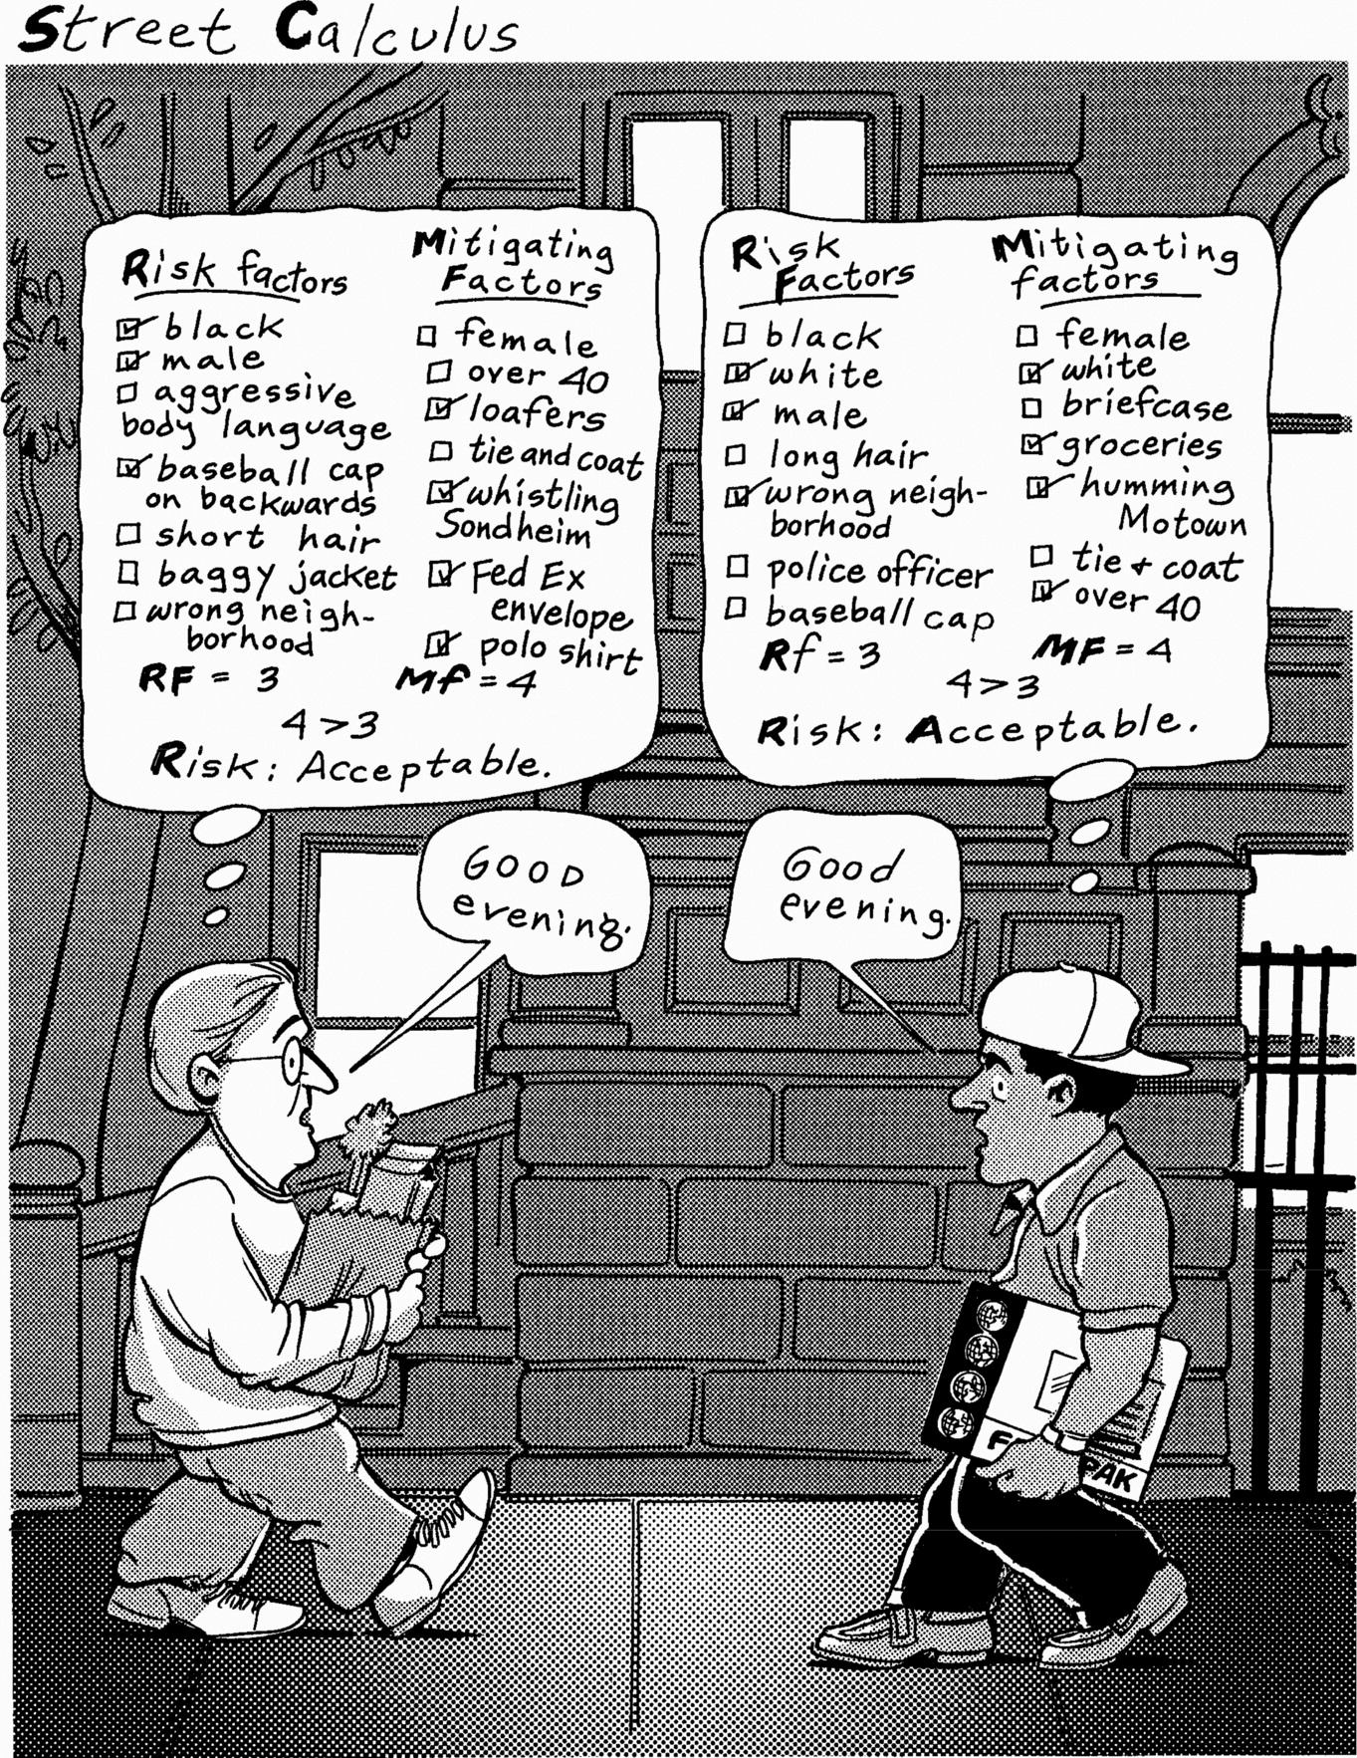

Slide 11
The Affect heuristics at work
Reliance on affect and emotion is a quicker, easier, and more efficient way to navigate in a complex, uncertain, and sometimes dangerous world.
When a person responds to an emotionally significant event, System 1 automatically searches its memory banks for related events, including their emotional accompaniments
If the activated feelings are pleasant, they motivate actions and thoughts anticipated to reproduce the feelings. If the feelings are unpleasant, they motivate actions and thoughts anticipated to avoid the feelings
Perceptions of risk and society’s responses to risk were strongly linked to the degree to which a hazard evoked feelings of dread (Slovic, 1987).
Thus activities associated with cancer are seen as riskier and more in need of regulation than activities associated with less dreaded forms of illness, injury, and death (e.g., accidents).

Slide 12
The affect heuristics - marketing
Why do entertainers often change their names? To make them affectively more pleasing
Why do movies have background music? After all, can’t we understand the events we are watching and the dialog we are hearing without music? Music conveys affect and thus enhances meaning even for common human interactions and events.
Why are all the models in the mail-order catalog smiling? To link positive affect to the clothing they are selling.
Why do packages of food products carry all those little blurbs such as “new,” “natural,” “improved,” or 98% fat free? These are “affective tags” that enhance the attractiveness of the product and increase the likelihood it will be purchased, much as adding “Save 98%” increased theattractiveness of saving 150 lives.

Slide 13
Risk and benefit correlation
Judgments of risk and benefit are negatively correlated, i.e. the greater the perceived benefit, the lower the perceived risk and vice versa.
Smoking, alcoholic beverages, and food additives, for example, tend to be seen as very high in risk and relatively low in benefit, whereas vaccines, antibiotics, and X rays tend to be seen as high in benefit and relatively low in risk.
In real world risk and benefits generally tend to be positively (if at all) correlated in the world: activities that bring great benefits may be high or low in risk but activities that are low in benefit are unlikely to be high in risk

Slide 14
Risk-as-feelings hypothesis
People base their judgments of an activity or a technology not only on what they think about it but also on what they feel about it.
If they like an activity, they are moved to judge the risks as low and the benefits as high; if they dislike it, they tend to judge the opposite—high risk and low benefit.
Emotional responses to risky situations, including feelings such as worry, fear, dread, or anxiety, often diverge from cognitive
Background moods (e.g., Johnson & Tversky, 1983), time intervals between decisions and their consequences (Loewenstein, 1987), vividness (Hendrickx et al., 1989), and evolutionary preparedness influence risk behaviors more than cognitions.

Slide 15
Risk-as-feelings hypothesis
Evolutionary reasons explain why people tend to react with little fear to certain types of objectively dangerous stimuli that evolution has not prepared them for, such as guns, hamburgers, automobiles, smoking, and unsafe sex, even when they recognize the threat at a cognitive level.
Other types of stimuli, such as caged spiders, snakes, or heights, which evolution may have prepared us to fear, evoke strong visceral responses even when we recognize them, cognitively, to be harmless.
“Our fear system evolved to deal with immediate threats. It’s not very good at dealing with gradually unfolding threats, like inflating market bubbles or global climate change. The smiling Bernie Madoff doesn’t seem scary, even though he should. He’s giving impossible returns year after year, but it’s not the kind of thing that triggers fear” (Loewenstein)
http://discovermagazine.com/2010/jan-feb/10#.UhiyMhvwbwk

