Slide 1
Anno Accademico 2014-2015
Corso Marketing
Lecture 17
Virtual AND AUGMENTED reality in marketing
Aim: To provide a basic introduction to the use of virtual and augmented reality in marketing.
Outline: Behavioral economics and marketing. Virtual reality and experiments. Virtual and augmented reality in marketing.
Readings:
Bainbridge, W. S. (2007). “The scientific research potential of virtual worlds.” Science 317, 472–476.
Harrison, G. W., E. Haruvy, and E. E. Rutström. (2011) “Remarks on Virtual World and Virtual Reality Experiments.” Southern Economic Journal 78, 87–94.
Rosenberg R.S., S. L. Baughman S.L., and J. N. Bailenson (2013) “Virtual Superheroes: Using Superpowers in Virtual Reality to Encourage Prosocial Behavior.” PLoS ONE 8(1).
Blogs, Videos and Websites:
Blog Laboratory of Virtual Reality and Economic Behavior
http://lavreb.wordpress.com/

Slide 2
Behavioral Economics and Marketing
Tips for supermarket
http://www.bonappetit.com/test-kitchen/how-to/article/supermarket-psychology
Behavioral economics and marketing
http://economiacomportamentale.wordpress.com/la-memetica/
Marcatori somatici
http://economiacomportamentale.wordpress.com/il-cervello/
Marketing Virale
http://economiacomportamentale.wordpress.com/marketing-virale/
Neuro Marketing
http://economiacomportamentale.wordpress.com/i-neuroni/
http://www.neurosciencemarketing.com/blog/

Slide 3
VIRTUAL EXPERIMENTS
Many experimental economists seem to view their enterprise as akin to silicon chip production. Subjects are removed from all familiar contextual cues. Like the characters 'thing one' and 'thing two' in Dr. Suess' Cat in the Hat, buyers and sellers become 'persons A and B', and all other information that might make the situation familiar and provide a clue about how to behave is removed.
George Loewenstein (1999)

Slide 4
Trust Game

Slide 5
The context free experiment
The context-free experiment is an elusive goal and not necessarily a good thing
Games in the laboratory are usually played without labels but subjects inevitably apply their own labels
A major discovery of cognitive psychology is how all forms of thinking and problem solving are context-dependent (language comprehension)
The laboratory is not a socially neutral context, but is itself an institution with its own formal or informal, explicit or tacit, rules

Slide 6
Internal vs. External Validity
Internal validity - ability to draw confident causal conclusions from one's research
External validity - ability to generalise from the research context to the settings that the research is intended to approximate
Experiments have the reputation of being high in internal validity but low in external validity
Field studies of being low in internal validity but high in external validity

Slide 7
Methodological Biases
One of the basic tenets of laboratory methodology is that the use of non-professional subjects and monetary incentives allows making subjects’ innate characteristics largely irrelevant
In some experiments, it is as if subjects take into the lab the preferences applied to real choices and stick to them with high probability
These biases or inclinations tend to override the incentives effect
Labels may give subjects clues to become less and not more rational

Slide 8
The power of labels
Subjects’ behavior depends more on prior learning outside the laboratory than on expected gains in the laboratory
Labels have the power to increase external validity with a minimal sacrifice of the internal validity
To test learning and cognitive models, it is necessary to remind and to evoke contexts which may activate emotions, association, similarities in the laboratory
The use of presentations with virtual reality (VR) visualisations can convey objectively this kind of information
A Virtual Experiment combines insights from virtual reality (VR) simulations in computer science, naturalistic decision making (NDM) and ecological rationality from psychology, and field and lab experiments from economics

Slide 9
Virtual Experiments
The methodological objective of Virtual Experiments is to combine the strengths of the artificial controls of laboratory experiments with the naturalistic domain of field experiments or direct field studies
In a virtual experiment the internal validity of controlled lab experiments is joined with the external validity of field experiments

Slide 10
Head Mounted Display

Slide 11
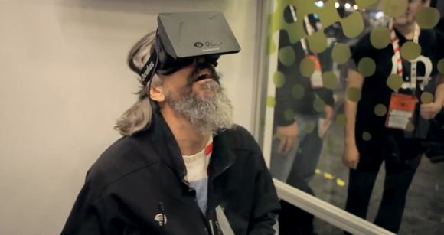
Oculus Rift

Slide 12
Tuscany Demo Oculus

Slide 13
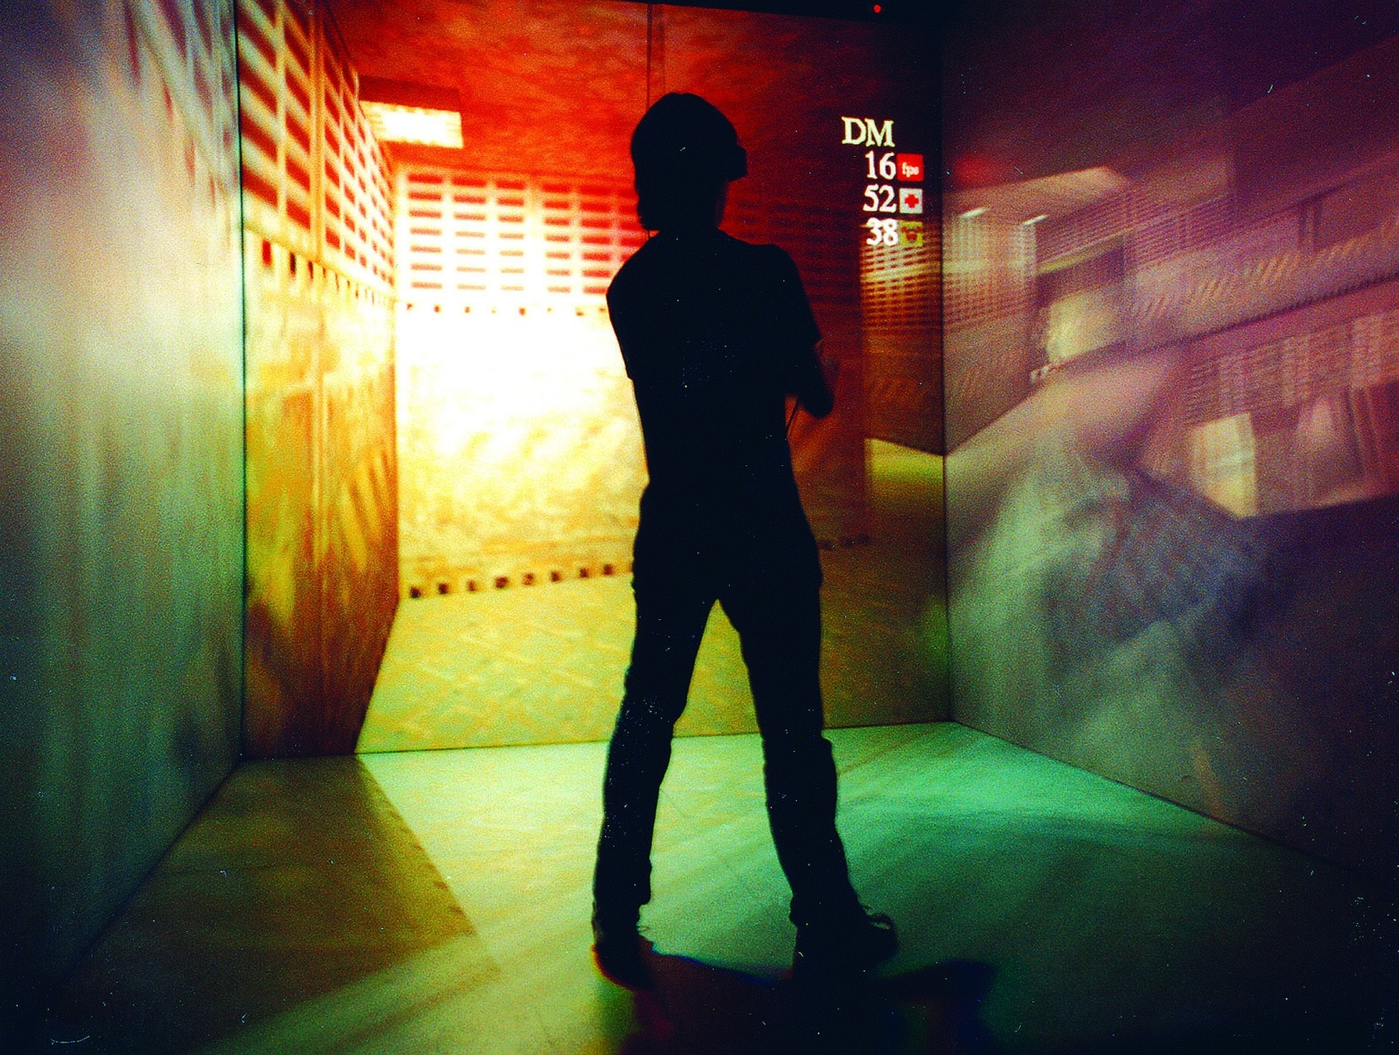
Cave

Slide 14
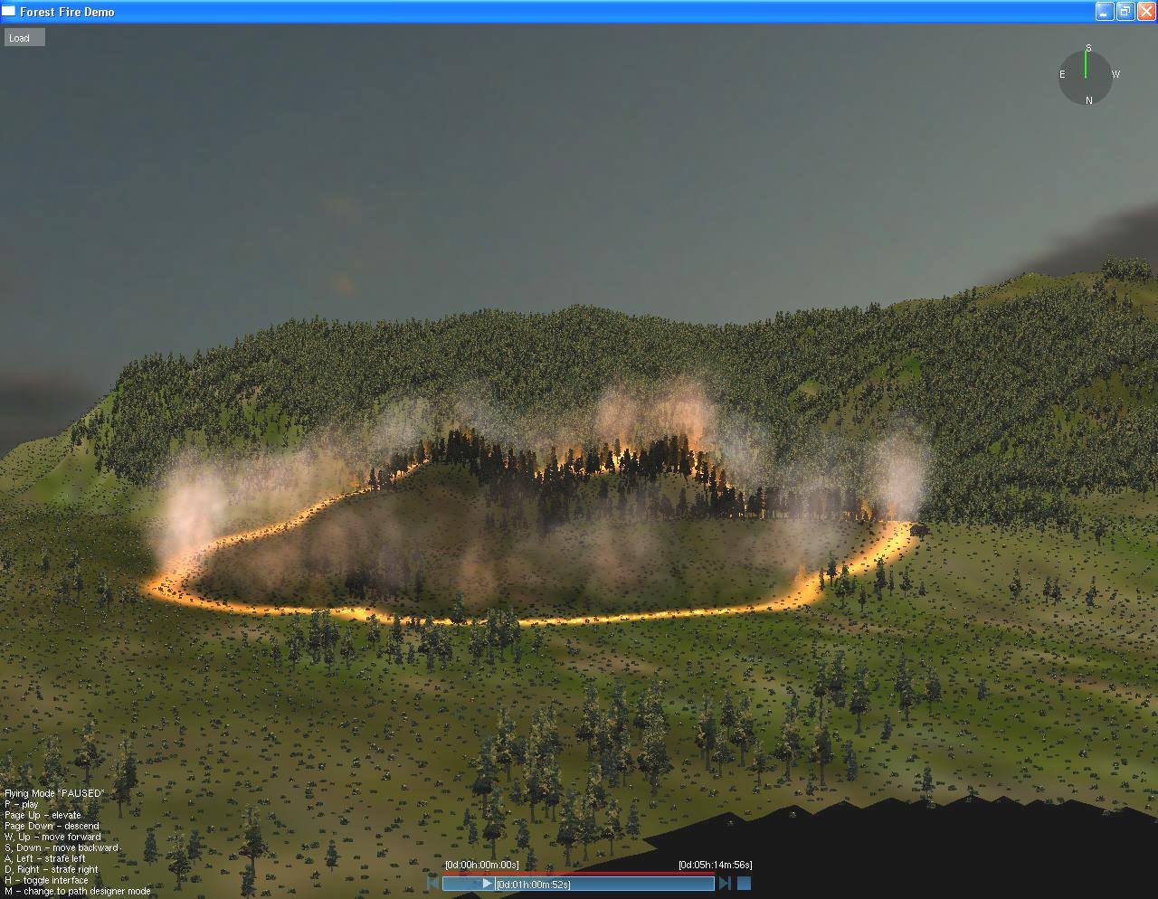
Virtual Simulations

Slide 15
Applications - ALBO Project
ALBO research programme aims at exploring the emergence and the dynamics of psychosocial risks among the employees of these organisations, as well as to develop virtual and immersive work environments for the assessment and management of those risks according to the provisions of country specific laws and regulations.
http://www.progettoalbo.it/
http://www.youtube.com/user/alessandroinnocenti1

Slide 16
Applications – Risk Perception
Fiore et al. 2009
Virtual Experiment to elicit subjective risk perception from wild fires and the opportunity cost of public funds allocated to prescribed burns
Subjects experience four dynamic visual simulations of specific wild fires, with varying weather and fuel conditions. Simulations are selected to represent high and low risk of fire damage
Participants experience a sense of presence, a psychological state of “being there and take decisions closer to real behavior (with cognitive constraints )

Slide 17
Applications – Risk Perception

Slide 18
Applications- Virtual Superheroes
to Encourage Prosocial Behavior
Background
Playing prosocial video games leads to greater subsequent prosocial behavior in the real world.
Thesis
In immersive virtual reality occupying an avatar with the superhero ability to fly increases helping behavior.
Methods
(two-by-two design) participants were either given the power of flight and were assigned one of two tasks, either to help find a missing diabetic child in need of insulin or to tour a virtual city.
Findings
The results indicate that having the “superpower” of flight leads to greater helping behavior in the real world

Slide 19
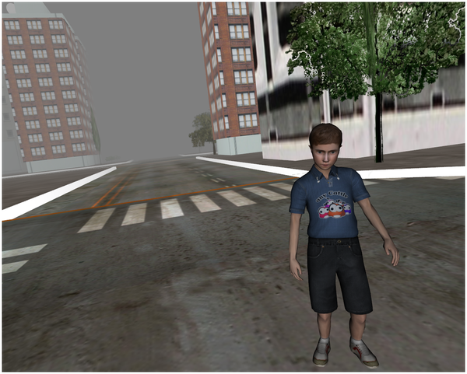
Figure 3. Virtual Child After Being Found and Saved.
Rosenberg RS, Baughman SL, Bailenson JN (2013) Virtual Superheroes: Using Superpowers in Virtual Reality to Encourage Prosocial Behavior. PLoS ONE 8(1): e55003. doi:10.1371/journal.pone.0055003
http://www.plosone.org/article/info:doi/10.1371/journal.pone.0055003

Slide 20
VIRTUAL REALITY and marketing
Experiencing is believing
http://www.theguardian.com/media-network/media-network-blog/2014/aug/28/marketing-virtual-reality-facebook-oculus-rift
In movie VR has the power to utterly disrupt the passive film viewing experience.
BBC has already opened the floodgates. During its recent coverage of the Commonwealth Games, Oculus Rift headsets could be used to submerse viewers into 360-degree videos and three-dimensional audio.
“We used to say seeing is believing. Now we have to say experiencing is believing.”
This means we can no longer solely rely on consumers’ inert viewing as a means of convincingly communicating marketing messages.
Brands could also use VR to improve personalised advertising.

Slide 21
VIRTUAL REALITY FOR MARKETERS
https://www.youtube.com/watch?v=BUuJiEs1sKU
http://www.fastcocreate.com/3037109/virtual-reality-for-marketers-5-ways-to-succeed-with-oculus-rift
TARGET CONSUMERS WITH MOBILE FIRST
IT’S NOT JUST ABOUT THE TECHNOLOGY, IT’S ABOUT THE CONTENT
GIVE USERS THE ABILITY TO CREATE CONTENT
GREAT CRAFT IS ESSENTIAL; POOR CRAFT WILL MAKE YOU SICK
ENGAGE AS MANY SENSES AS POSSIBLE

Slide 22
augmenteD REALITY FOR MARKETing
http://www.augmentedrealitytrends.com/augmented-reality-retail/retail-campaign.html
Strategic Goal
When you are adding AR for promoting your retail brand, there should a clear goal which is measurable.
Integrating with Real World
With AR, you can smoothly connect the physical and the digital world. Web services that you provide can thus be connected with physical content.
Custom AR Experience
If you are able to create a unique and personalized AR experience for your consumers nothing can be better.
Surprising the Consumers
You need to provide something unique to your consumers if you want to draw their attention.

Slide 23
augmenteD REALITY FOR MARKETers
http://wedu.com/blog/index.php/augmented-reality-bringing-3d-virtual-reality-to-real-world-marketing-campaigns/
Product Packaging- Starbucks Uses AR to Show Some Holiday Love
Online Commerce- Bella Luce’s AR App Lets You Try a Ring on Before You Buy It
Print Advertising- Blippar Tricks Out Virgin Media Magazine Using AR
Product Packaging – LEGO Uses AR to Show Products in 3D
The future of augmented reality

