Slide 1

Course Behavioral Economics Alessandro Innocenti
Academic year 2013-2014
Lecture 9 Heuristics and Biases
Lecture 9 heuristics and biases
Aim: To illustrate some heuristics and biases affecting economic decision-making.
Outline: Anchoring. Availability. Representativeness.
Readings:
Kahneman, D. (2011) Thinking, Fast and Slow, Farrar, Straus and Giroux, New York, chapt. 11-12-14-15.
Tversky, A. and D. Kahneman (1974), “Judgment under Uncertainty: Heuristics and Biases,” Science, 185, 1124-1131.
Blogs, Videos and Websites
Anchoring, with Daniel Kahneman
http://www.youtube.com/watch?v=HefjkqKCVpo (1:50)

Slide 2
Anchoring
Amos Tversky and Daniel Kahneman (1974) asked people to estimate how many African countries were part of the United Nations, but first they spun a wheel of fortune.
The wheel was painted with numbers from 0 to 100, but rigged to always land on 10 or 65. When the arrow stopped spinning, they asked the person in the experiment to say if they believed the percentage of countries was higher or lower than the number on the wheel.
They then asked people to estimate what they thought the actual percentage of nations was.
They found people who landed on 10 in the first half of the experiment guessed around 25 percent of Africa was part of the U.N. Those who landed on 65 said around 45 percent.
No one really knew what the answer was. They had to guess, yet it didn’t feel like a guess. As far as they knew, the wheel was a random number generator, but it produced something concrete to work

Slide 3
definition
Tversky and Kahneman (1974)
“In many situations, people make estimates by starting from an initial value that is adjusted to yield the final answer. The initial value, or starting point, may be suggested by the formulation of the problem, or it may be the result of a partial computation. In either case, adjustments are typically insufficient (Slovic & Lichtenstein, 1971). That is, different starting points yield different estimates, which are biased toward the initial values. We call this phenomenon anchoring.”
Anchoring is a cognitive bias according to which people tend to rely on the first piece of information offered (the "anchor") in making judgments or taking decisions.
Once an anchor is set, subsequent judgments or decisions are made by adjusting away from that anchor
The anchoring creates a bias toward interpreting correctly new information about the decision.

Slide 4
Anchoring in marketing
When people make quantitative estimates, their estimates may be heavily influenced by previous values of the item.
For example, the initial price offered for a used car sets the standard for the rest of the negotiations, so that prices lower than the initial price seem more reasonable even if they are still higher than what the car is really worth.
The salesman is trying to get the consumer anchored on the high price so that when he offers a lower price, the consumer will estimate that the lower price represents a good value.
Producers prefer to anchor to a higher priced alternative (rather than lower) even by creating an artificial alternative

Slide 5
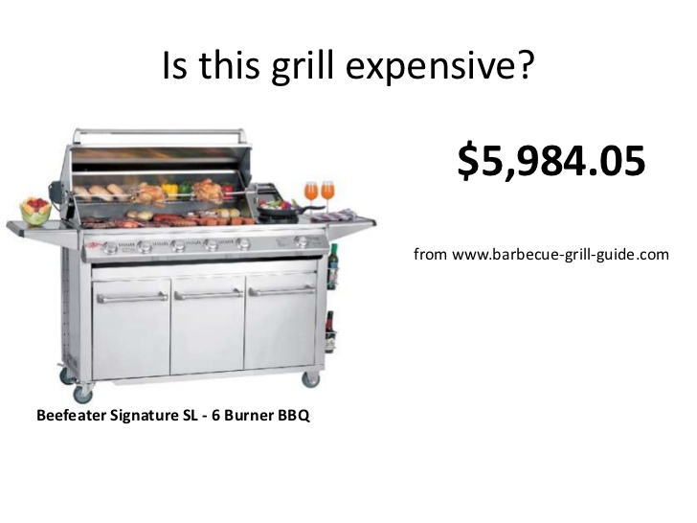
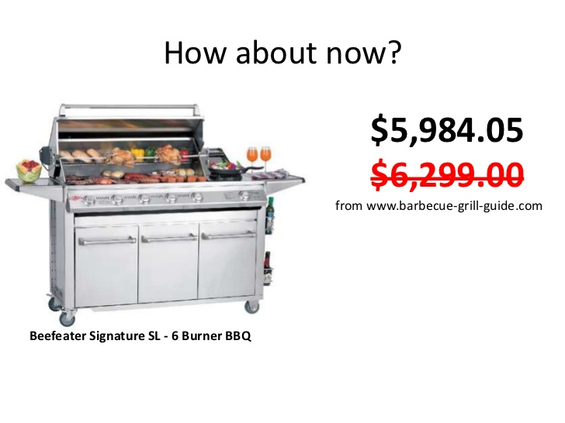
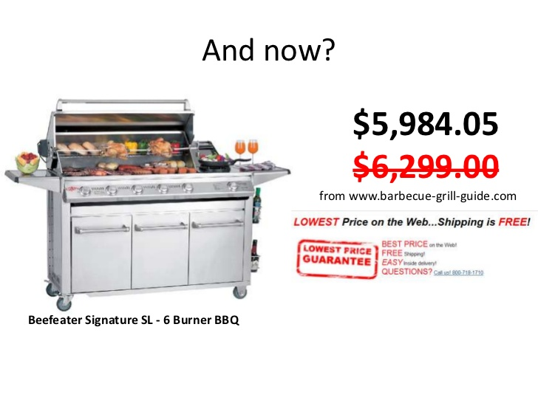
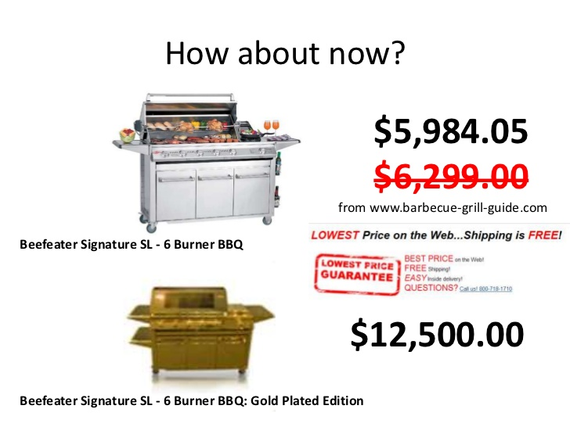
Anchoring in marketing

Slide 6
Anchoring in financial markets
Overconfidence and anchoring definitely appear to be part of the explanation underlying post-earnings-announcement drift.” (Shefrin 2000)
If the analysts are overconfident and also anchored to their most recent estimate, they may be reluctant to give as much weight as they should to the information in the current earnings announcement and not raise their estimate.
They cause underreaction and the conditions under which investors are vulnerable to these heuristics are different from the conditions that cause investors to be vulnerable to overreaction.
Underreaction is likely due to biases associated with the overconfidence and anchoring heuristics and may be the source of the alpha* for most momentum and earnings surprise strategies. (Fuller 2000)
*alpha is a risk-adjusted measure of the
active return on an investment

Slide 7
Availability
An availability heuristic is a mental shortcut that relies on immediate examples that come to mind to take a decision
You might judge that those events are more frequent and possible than others andgive greater credence to this information and tend to overestimate the probability and likelihood of similar things happening in the future.
The availability heuristic implies people predict the frequency of an event based on how easily an example can be brought to mind
Availability is also a useful clue for assessing frequency or probability, because instances of large classes are usually recalled better and faster than instances of less frequent classes “ (Tversky and Kahneman 1974)

Slide 8
Availability
The news can affect our availability heuristic by producing vivid memories that are more readily available. For instance, if the news has recently reported on large forest fires, we are more likely to believe that forest fires are on the rise because the memory appears vivid and is readily available
After seeing news reports about people losing their jobs, you might start to believe that you are in danger of being fired.
After seeing several television programs on shark attacks, you start to think that such incidences are relatively common. When you go on vacation, you refuse to swim in the ocean because you believe the probability of a shark attack is high.
After reading an article about lottery winners, you start to overestimate your own likelihood of winning the jackpot and you start spending more money than you should each week on lottery tickets.

Slide 9
Availability and risk
“Perhaps the most obvious demonstration of availability in real life is the impact of the fortuitous availability of events or scenarios. Many readers must have experienced the temporary rise in the subjective probability of an accident after seeing a car overturned by the side of the road. Similarly, many must have noticed an increase in the subjective probability that an accident or malfunction will start a thermonuclear war after seeing a movie in which such an occurrence was vividly portrayed. Continued preoccupation with an outcome may increase its availability, and hence its perceived likelihood. People are preoccupied with highly desirable outcomes, such as winning the sweepstakes, or with highly undesirable outcomes, such as an airplane crash. Consequently, availability provides a mechanism by which occurrences of extreme utility (or disutility) may appear more likely than they actually are.“
(Amos Tversky and Daniel Kahneman, 1973, "Availability: A heuristic for judging frequency and probability." Cognitive Psychology, 5(1), 207-233)

Slide 10
The Availability cascade
Thaler and Sunstein (1999)
An availability cascade is a self-reinforcing process of collective belief formation by which an expressed perception triggers a chain reaction that gives the perception increasing plausibility through its rising availability in public discourse.
The driving mechanism involves a combination of:
informational cascade, in which uninformed people base their own beliefs on the apparent beliefs of others
reputational cascades, in which earning social approval or avoiding social disapproval affects how personal opinions are expressed or withheld.
Individuals endorse the perception partly by learning from the apparent beliefs of others and partly by distorting their public responses in the interest of maintaining social acceptance.

Slide 11
The Availability cascade
Thaler and Sunstein (1999)
“Availability entrepreneurs” - who manipulate the public discourse – exploit availability cascades to advance their agendas
Their availability campaigns may yield social benefits, but sometimes they bring harm, which suggests a need for safeguards.
the rise and decline of McCarthyism
the struggle for black civil rights
the rise of the anti-tax movement
campaigns against smoking
the spread of ethnic and religious separatism
global turn toward market-friendly government policies

Slide 12
representativeness
when judging the probability of some uncertain event people resort to rules of thumb which are less than perfectly correlated (if, indeed, at all) with the variables that actually determine the event’s probability
subjective judgment of the extent to which the event in question “is similar in essential properties to its parent population” or “reflects the salient features of the process by which it is generated”
decisions are made based on how representative a given individual case appears to be independent of other information about its actual likelihood.

Slide 13
tom w’s personality sketch
“Tom W. is of high intelligence, although lacking in true creativity. He has a need for order and clarity, and for neat and tidy systems in which every detail finds its appropriate place. His writing is rather dull and mechanical, occasionally enlivened by somewhat corny puns and by flashes of imagination of the sci-fi type. He has a strong drive for competence. He seems to feel little sympathy for other people and does not enjoy interacting with others. Self-centered, he nonetheless has a deep moral sense."
The participants divided into three separate groups
The first group was asked how similar Tom was to one of nine different college majors. Most believed Tom was most similar to an engineering student and least similar to a social science student.
The second group was asked to rate the probability that Tom was one of the nine faculties. The probabilities given by the participants in the second group were very similar to the responses given by those in the first group.
The third group was asked a question unrelated to Tom's description. They were asked to estimate what percentage of first-year graduate students were in each of the nine faculties
People were highly likely to believe that Tom was an engineering major, despite the fact that there was a relatively small number of engineering students at the school where the study was conducted.

Slide 14
LINDA is a bank teller
Tversky and Kahneman (1983)
“Linda is 31 years old, single, outspoken, and very bright. She majored in philosophy. As a student, she was deeply concerned with issues of discrimination and social justice, and also participated in anti-nuclear demonstrations.”
Which of the following two alternatives is more probable?
1. Linda is a bank teller.
2. Linda is a bank teller and active in the feminist movement.
Rationally, statement 2 cannot be more likely than statement 1 but 85 percent of respondents said that it was.
In making this kind of judgment subjects seek the closest resemblance between causes and effects (here, between Linda’s personality and her behavior) rather than calculating probability and that this makes statement 2 seem preferable.

Slide 15
Excerpts from
Thinking, fast and slow
“it is natural for System 1 to generate overconfidence judgments, because confidence is determined by the coherence of the best story you can tell from the evidence at hand.” (p. 194)
“The most coherent stories are not necessarily the most probable, but they are plausible, and the notions of coherence, plausibility, and probability are easily confused by the unwary.” (p. 159)
“System 2 is not impressively alert. (…) Its laziness is an important fact of life, and the observation that representativeness can block the application of an obvious logical rule is also of some interest.” (p. 164)

