Slide 1

Course Behavioral Economics Alessandro Innocenti
Academic year 2013-2014
Lecture 7 The associative mechanism
Lecture 7 the associative mechanism
Aim: To discuss mental mechanism of the association of concepts and ideas.
Outline: Priming. Cognitive ease and cognitive strain. Implicit association theory. Mere exposure effect.
Readings:
Kahneman, D. (2011) Thinking, Fast and Slow, Farrar, Straus and Giroux, New York, chapt. 4-5.
Bateson M., D. Nettle, and G. Roberts. (2006) “Cues of being watched enhance cooperation in a real-world setting”, Biology Letters, 2, 412-414.
Blogs, Videos and Websites:
Implicit Association Test (IAT) demo
https://implicit.harvard.edu/implicit/demo/

Slide 2
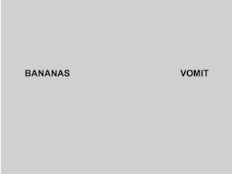

Slide 3
What’s happened?
You saw those two words
People recoil from the word "vomit“
You actually move backward
You make a face of disgust
You feel a bit bad
The disgust forcing your face into a particular expression changes the way you feel.
Then you have made a story with two words that have nothing to do with each other
There is now a connection between those two, the banana has somehow caused the vomit
What happens is that your associative memory has changed shape.

Slide 4
PRIMING
Priming is an operation of System 1 which creates links by means of associative activations in a cascade without awareness
In this case you made up a causal story, that is the vomit, which looks like an effect here, is looking for causes, and so System 1 are making up scenarios.
All of this is happening involuntarily, most of it is happening unconsciously, but you are primed, that is words are linked in a causal story.
It may happen that System 1 constructs a story and system 2 believed it

Slide 5
THE FLORIDA EFFECT
Priming is not restricted to concepts and words but also to actions and emotions
Half of a group of college students were asked to arrange brief sentences including at least one of the words Florida, forgetful, bald, gray, or wrinkle.
The other half were presented with none of these words.
After completing their task, the students were told to walk down the corridor to another room.
The experimenters, unbeknownst to the subjects, recorded the time the students took to walk that short distance.
The students in the “words” group walked more slowly than those in the other group.
The unconscious association of terms commonly associated with being old affected the students’ walking pace.

Slide 6
Money priming
http://wiki.mgto.org/money_priming_using_scrambled_sentence_task
Experiment 'unscramble the sentence'
Subjects should unscrambled sentences with a money theme (e.g.: make a 4 word sentence out of “high salary desk paying a”) and also by using smaller stimuli e.g. placing a monopoly board on the table in front, or a computer screen in the room with a $ bill screen saver.
Exposure to money produced the following results
Self Reliance: Money primed subjects persevered twice as long on tougher problems before asking for help
Selfishness: They were MUCH less willing to help a student who pretended to be confused about the task. And, when an experimenter clumsily dropped a bunch of pencils, they picked fewer pencils

Slide 7
PRIMING EFFECTS
Less Open/Connected: When money primed subjects were told they were to set up two chairs for a conversation with a researcher, they kept their chairs 118cm apart (vs 80 cm on average), and showed a greater preference for being left alone
Reminding people of money inceases individualism, reluctance to be involved with others and to depend on others
Reminding people of their mortality increases the appeal of authoritarian ideas, which may become reassuring
Inducing people to lie to an imaginary person either on the phone or in e-mail push those who ahd lied on the phone to prefer mouthwash over soap and those whp had lied in email preferred soap to mouthwash

Slide 8
Priming effect on giving
Bateson, Nettle, and Roberts (2006) examine the relationships between the level of contribution to an honesty box (i.e., a container used to collect money for something to buy without the presence of an attendant) and the feeling of being observed by the image of a pair of eyes.
They found that the level of contribution is sharply higher in the presence of the cue of being watched than in the presence of a control image of flowers.
This result is confirmed by Haley and Fessler (2005), who find that eye-spots tend to increase the generosity of participants
Burnham and Hare (2007), who investigate the effect of being watched by the eyes of a robot on public goods contribution.

Slide 9
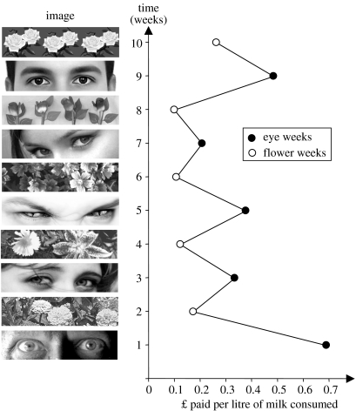

Slide 10
COGNITIVE EASE AND COGNITIVE STRAIN
Cognitive ease is the mental state in which “things are going well – no threats, no major news, no need to redirect attention or mobilize effort”
If an individual’s thought process has successfully utilized System 1, in that it required no extra effort by System 2 to complete the said task, that individual is experiencing cognitive ease.
Cognitive strain on the other hand, “indicates that a problem exists, which will require increased mobilization of System 2”.
Cognitive strain triggers the mind to use System 2’s extra resources and analyze the situation more thoroughly.
When under cognitive ease, individuals make decisions in a completely different manner than when under cognitive strain.

Slide 11
Cognitive Reflection Test
http://www.sjdm.org/dmidi/Cognitive_Reflection_Test.html
Subjects were submitted tests including mathematical questions evoking an immediate intuitive answer that is incorrect (ex. bat and ball)
bat and a ball
If it takes 5 machines 5 minutes to make 5 widgets, how long would it take 100 machines to make 100 widgets?
In a lake, there is a patch of lily pads. Every day, the patch doubles in size. If it takes 48 days for the patch to cover the entire lake, how long would it take for the patch to cover half of the lake?
To simulate cognitive strain, two tests were written with identical questions, except one test had a smaller, slightly illegible, font and the other had a normal legible font.
The smaller font induced cognitive strain, while the legible font did not.
90% of the students who saw the CRT in normal font made at least one mistake in the test, but the proportion dropped to 35% when the font was barely legible

Slide 12
APPLICATIONS
Cognitive strain, whatever its source, mobilizes System 2, which is more likely to reject the intuitive answer suggested by System 1
Cognitive strain forces the mind and individual to avoid its lazy tendencies and work harder, thus triggering System 2.
Knowing that system two is triggered in situations that instill cognitive strain can be helpful in many professional settings.
Successful managers and executives are able to inspire their workers to perform their absolute best by inducing slight cognitive strain.
Managers can create a sense of urgency. “Perhaps the best way to challenge the status quo is for a leader to forcefully create a sense of urgency” (Dess, Lumpkin and Eisner 2011)
This urgency may induce cognitive strain and trigger System 2 by enabling individuals to use more resources in order to analyze situations better and make better decisions.

Slide 13

Staring eyes 'deter’ bike thieves
Bike thefts have been reduced by putting pictures of staring eyes above cycle racks, researchers have found.
A team from Newcastle University decided to test the theory that people behave better when they think they are being watched.
For two years they studied crime rates at campus racks and found a drop of 62% at those which displayed eye posters.
http://www.bbc.co.uk/news/uk-england-tyne-22270052

Slide 14
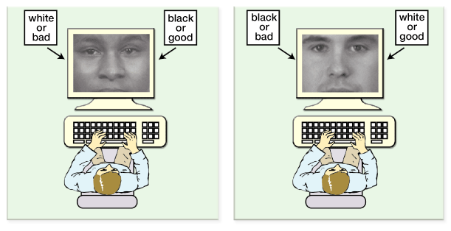
IMPLICIT ASSOCIATION
IMPLICIT ASSOCIATION is the unconscious attachment of an emotional attitude or belief to something (object, experience, type of animal or social category)
IAT tests claim to tap into emotional attitudes by measuring mental processes that are unconscious and over which we have no control
https://implicit.harvard.edu/implicit/demo/

Slide 15
MERE EXPOSURE EFFECT
Robert Zajonc 1968
The repetition of an arbitrary stimulus creates mild addiction for it.
Zajonc (1968) demonstrated the mere exposure effect in three experiments. He showed participants stimuli with different exposure frequencies and asked them to rate their favorability towards the stimuli. The first experiment used nonsense words as stimuli, the second used Chinese-like characters, and the third used photos from a yearbook. The more the participants were exposed to a stimulus, the more they liked it - See more at: http://www.citelighter.com/science/psychology/knowledgecards/mere-exposure-effect#sthash.2aKpi5Ql.dpuf
The effect occurs because the repetition of a stimulus is followed by nothing bad and in this way becaome a safety signal
To survive in a frequently dangerous world an organism learns to react cautiously to novel simuli with withdrawal and fear

Slide 16
MERE EXPOSURE EFFECT - APPLICATIONS
unconscious familiarity is more important than conscious recognition
apart from creating brand awareness, advertising gets you so familiar with a brand that you naturally start preferring it
preference shift towards McDonald's in little kids.
more television the children watched, the more they preferred food with a fast food label.
even if little kids do not understand the advertisements for the new southwestern chicken salad at McDonald's, or comprehend those billboards for McDonald's ice coffee, they were exposed repeatedly to the golden arches, and that exposure made them like the brand.

Slide 17
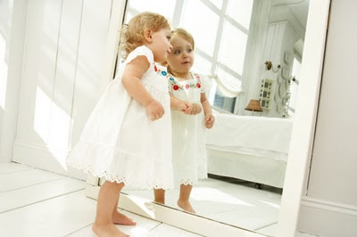
Mirror image
People prefer their mirror image over their actual image due to the mere-exposure effect
http://www.youtube.com/watch?v=afA8TjqqeVc#t=121

