Slide 1

Course Behavioral Economics Alessandro Innocenti
Academic year 2013-2014
Lecture 6 Dual System
Lecture 6 DUAL SYSTEM
Aim: To introduce dual theories of mind and their implication for decision theory.
Outline: Kahneman’s Nobel prize lecture. Dual systems. Attention and effort. The lazy controller.
Readings:
Kahneman, D. (2003) "Maps of bounded rationality: psychology for behavioral economics", The American Economic Review, 93, 1449–1475.
Kahneman, D. (2011) Thinking, Fast and Slow, Farrar, Straus and Giroux, New York, chapt. 1-2-3.
Blogs, Videos and Websites:
Prize Lecture by Daniel Kahneman (37:28)
http://www.youtube.com/watch?v=5aG68FLYd9s

Slide 2
Kahneman’s project
To explore the systematic biases that separate the beliefs that people have and the choices they make from the optimal beliefs and choices assumed in rational-agent economic models
intuitive judgment and choice
vs.
preferences and attitudes
Model of judgment heuristics
Key principles
reasoning is done deliberately and effortful
intuitive thoughts come spontaneously to mind without search, computation or effort
most judgments and most choices are made intuitively
rules that govern intuition are generally similar to the rules of perception

Slide 3
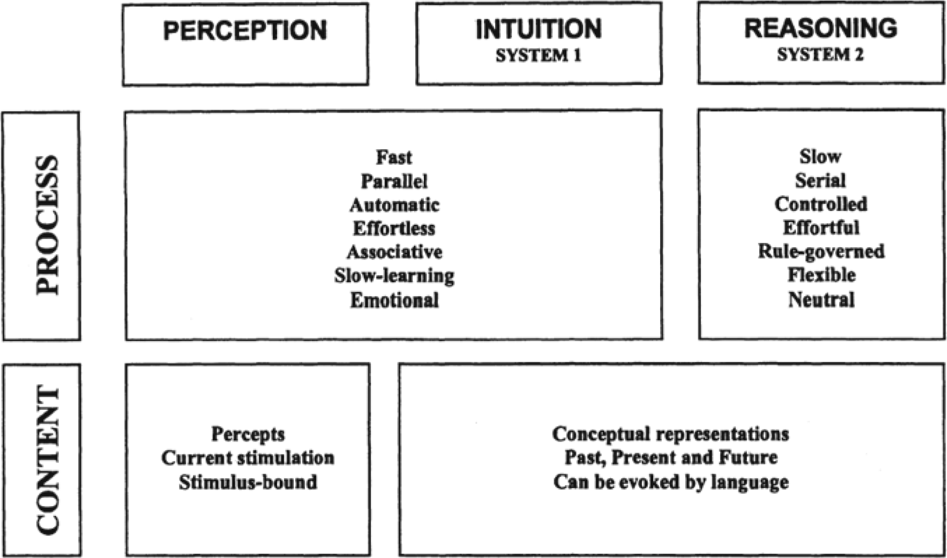

Slide 4
SYSTEM 1 AND SYSTEM 2
The perceptual system and the intuitive operations of System 1 generate impressions of the attributes of objects of perception and thought. These impressions are not voluntary and need not be verbally explicit.
In contrast, judgments are always explicit and intentional, whether or not they are overtly expressed. Thus, System 2 is involved in all judgments, whether they originate in impressions or in deliberate reasoning.
Difference in effort provides the most useful indications of whether a given mental process should be assigned to System 1 or System 2.
Intuitive judgments occupy a position—perhaps corresponding to evolutionary history—between the automatic operations of perception and the deliberate operations of reasoning.

Slide 5
SYSTEMS 1 and 2 activities
System 1 | System 2
Detect that one object is more distant than another | Focus attention on the clowns in the circus
Complete the phrase “bread and…” | Focus on the voice of a particular person in crowded and noisy rooms
Make a “disgust face” when shown a horrible picture | Maintain a faster walking speed than is natural for you
Detect hostility in a voice | Monitor the appropriateness of your behavior in a social situation
Answer to 2+2=? | Tell someone your phone number
Drive a car on an empty road | Park in a narrow space
Find a strong move in chess (if you are a chess master) | Compare two washing machines for overall value
Understand simple sentences | Check the validity of a complete logical argument

Slide 6
SYSTEM 1 vs. system 2
The capabilities of System 1 include human skills that we share with other animals
People are born prepared to perceive the world around us, recognize objects, orient attention, avoid losses, and fear spiders
Other activities are learnt by System 1 by making associations between ideas (such as the master chess player)
Many activities of System 1 are completely involuntary while others, such as chewing, are susceptible of voluntary control but normally run on automatic pilot (accessibility)
System 2 is tuned to pay attention and has some ability to change the way system works by programming the normally automatic functions of attention and memory
When you rent a car in UK you should pay attention to drive on the left side of the road

Slide 7
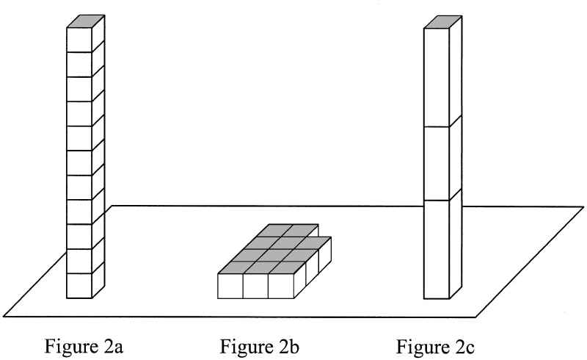
HIGH AND LOW ACCESSIBILITY the ease with which mental contents come to mind is accessibility

Slide 8
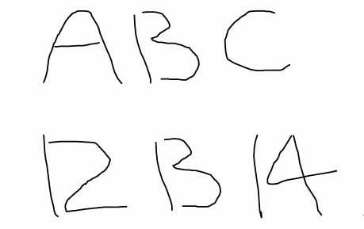
ACCESSIBILITY AND CONTEXT

Slide 9
ACCESSIBILITY AND EXPECTATIONS
Expectations (conscious or not) are a powerful determinant of accessibility.
Ambiguity and uncertainty are suppressed in intuitive judgment as well as in perception
It is different to see the two versions in close proximity or separately because observers will not spontaneously become aware of the alternative interpretation.
Doubt is a phenomenon of System 2, an awareness of one’s ability to think incompatible thoughts about the same thing.
Klein (1998) experienced decision makers working under pressure (e.g., firefighting company captains) rarely need to choose between options because, in most cases, only a single option comes to mind.

Slide 10
BERNOULLI’S ERROR
Perception is reference-dependent: the perceived attributes of a focal stimulus redirect the contrast between that stimulus and a context of prior and concurrent stimuli.
Immersing the hand in water at 20°C will feel pleasantly warm after prolonged immersion in much colder water, and pleasantly cool after immersion in much warmer water.
In contrast, standard economics assumes that the utility of decision outcomes is determined entirely by the final state of endowment, and is therefore reference-independent.
Kahneman defines Bernoulli’s error the proposition that decision makers evaluate outcomes by the utility of final asset positions which has been retained in economics for almost 300 years.

Slide 11
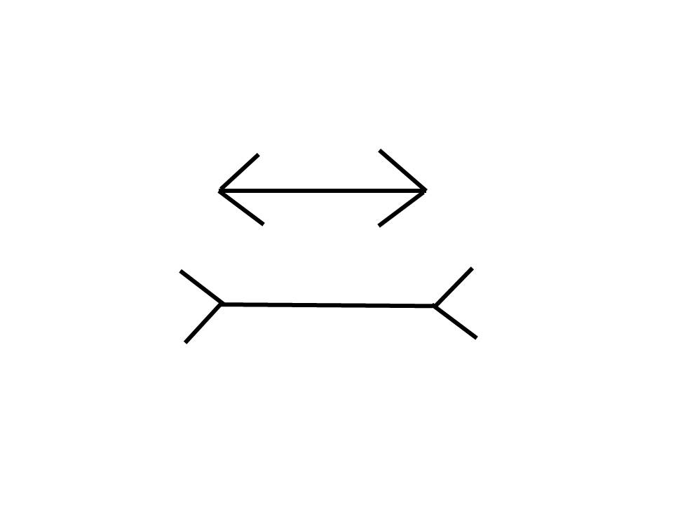
ILLUSIONS

Slide 12
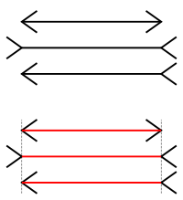
MÜller-lyer ILLUSIONS

Slide 13
COGNITIVE AND VISUAL ILLUSIONS
System 1 sees that the bottom line is longer than the top line
System 2 realizes from measurement in the second slide that the lines are equally long
But if you look again at the first slide the bottom line appears longer
There is no way to prevent System 1 from generating a wrong impression because it operates automatically and cannot be turned off at will
Biases cannot be avoided because System 2 have no clue to the error and is to slow and inefficient to serve as a substitute for System 1 in making routine decisions
Solution: learn to recognize situations in which mistakes are likely and to monitor them

Slide 14
Attention and effort
http://www.youtube.com/watch?v=IGQmdoK_ZfY
Add-3 task
To start, make up several strings of 4 digits, all different, and write each string on an index card.
Place a blank card on top of the deck.
Start beating a steady rhythm.
Remove the blank card and read the four digits aloud.
Wait for two beats, then report a string in which each of the original digits is incremented by 3.
If the digits on the card are 5294, the correct response is 8627.
Keeping the rhythm is important.
http://www.youtube.com/watch?v=qMy_6Pgiokk#t=47
http://healthresearchblog.blogspot.it/2011/11/working-memory-with-r-code.html

Slide 15
PUPIL SIZE
The changing size of your pupils is a faithful record of how hard you worked
Pupils’ sizes are sensitive indicators of mental effort
More the effort is hard more they dilate but with an inverted V
Add-1 causes a larger dilation then the task of holding seven digits for immediate recall
Add-3 in the first 5 seconds the pupil dilates by about 50% of its original area and heart rate increases by about 7 beats per minute. This is as hard as people can work and they give up. When exposed to more digits their pupils stopped dilating or actually shrank

Slide 16
SYSTEM 1’S QUICK RESPONSES
Pupils offer an index of the current rate at which mental energy is used
System 2 have limited capacity and this capacity is allocated second by second to other tasks
You cannot allocate attention to others (the invisible gorilla)
But orienting and responding quickly to threats or promising opportunities improves the chance of survival
System 1 takes over in emergencies and assign total priority to self-protective actions

Slide 17
SELF-CONTROL
System 1 has more influence on behavior when System 2 is busy
People who are cognitively busy are also more likely to make selfish choices, use sexist language and make superficial judgments in social situations
Add-3 loosens the hold on System 2 on behavior as few drinks or a sleepless night
Too much concern about how well one is doing in a task sometimes disrupts performance by loading short-term memory with pointless anxious thoughts (fast and frugal)
Self-control requires attention and effort and is a task of System 2 who monitor and control thoughts suggested by System 1

Slide 18
Question 1
A bat and ball cost $1.10.
The bat costs one dollar more than the ball.
How much does the ball cost?
Question 2
Is the following argument logically valid?
All roses are flowers.
Some flowers fade quickly.
Therefore some roses fade quickly.

Slide 19
Bad Intuitive judgments
Answer to Q.1 : 10 cents (50-56% among University students - 80% among lay people)
Answer to Q.2 : Yes. Flawed because it is possible that there are no roses among the flowers that fade quickly
Humans are not accustomed to thinking hard and are often content to trust a plausible judgment that quickly comes to mind
The rate of errors in these experiment is good predictor of high discount rate

Slide 20
THE ORIGIN OF BIASES
System 1 detects simple relations (i.e. “they are all like”) and integrate information about one thing at a time but it does not deal with multiple distinct topics at once
System 2 follow rules, compare objects on several attributes and make deliberate choices between options, adopt “task sets”, i.e. program memory to obey an instruction that overrides habitual responses
But people are overconfident and prone to place too much faith in their intuitions because they find cognitive effort mildly unpleasant and avoid it as much as possible

