Slide 1
Course Behavioral Economics Alessandro Innocenti
Academic year 2013-2014
Lecture 5 Cognitive economics and neuroeconomics
Lecture 5 Cognitive economics and Neuroeconomics
Aim: To provide an introduction to cognitive economics and neuroeconomics.
Outline: Cognitive economics and neuroeconomics: key principles. Tools. Basic facts about the brain. Cognitive processes. Automatic processes. Affective processes. Main findings. Implication for economics. A critique of neuroeconomics.
Readings:
Camerer, C. F., G. Loewenstein, and D. Prelec (2005) “Neuroeconomics: How Neuroscience Can Inform Economics”, Journal of Economic Literature, XLIII, 9-64.
G. W. Harrison (2008) “Neuroeconomics: A Rejoinder”, Economics and Philosophy, 24, 533-544.
Blogs, Videos and Websites:
Predicting Consumer Choices with Neuroeconomics
http://www.behaviouraldesignlab.org/latestarticles/predicting-consumer-choices-with-neuroeconomics

Slide 2
COGNITIVE ECONOMICS
Cognitive economics is not a distinct subfield of economics but a school of thought based on the idea that the study of economic behaviour has to be founded on the interdisciplinary approach of cognitive sciences
The research field of Cognitive Science is formed by the intersection of a variety of different disciplines including cognitive psychology, philosophy of mind, linguistics, artificial intelligence and neuroscience
The field of cognitive economics is the analysis of the mental and cognitive processes through which the economic agent collects, processes, interprets and uses information and knowledge to make economic choices.
Its main object is to open the black-box containing all the processes through which preferences are formed and are translated into choices.
Cognitive economics departs from behavioral economics, whose methodology is based on the analysis of the effectively exhibited behaviors, which is consonant with the axiom of revealed preferences and allows ignoring the mental processes leading to decisions or judgments.

Slide 3
NEUROECONOMICS
Neuroeconomics is a sub-field of cognitive economics
Studies how the brain interacts with the environment to produce economic behavior
Neuroeconomics is the grounding of microeconomics in details of neural functioning.
While the revealed preferences approach has deliberately avoided trying to discover the neural determinant of choices, neuroscience is beginning to allow direct measurement of thoughts and feelings
Methodologically, neuroeconomics is not intended to test economic theory in a traditional way - particularly under the view that utilities and beliefs are only revealed by choices - but to establish the neural circuitry underlying economic decisions, for the eventual purpose of making better predictions.

Slide 5
BASIC PRINCIPLES
Much of the brain is constructed to support automatic processes which are faster than conscious deliberation and which occur with little or no awareness or feeling of effort
Economic behavior is under the pervasive and often unrecognized influence of finely tuned affective (emotion) systems that are localized in particular brain region
If affective systems are damaged or perturbed by brain damage, stress, imbalances in neurotransmitters, alcohol or “the heat of the moment” the deliberative system generally is not capable of getting the job done
Many behaviors that are clearly established to be caused by automatic or affective systems are interpreted by human subjects, spuriously, as the product of cognitive deliberation
The deliberative system, which is the system that is responsible for making sense of behavior, does not have perfect access to the output of the other systems, and exaggerates the importance of processes it understands when it attempts to make sense of the body’s behavior.

Slide 6
TOOLS
Animal studies
Human studies
Lesion studies (i.e., studies of patients with deficits that follow specific brain damage)
Single neuron measurement (non-human mammals)
Eye-tracking
Measuring hormone levels
Physiological activations (Heart rate, Skin conductance level, Blood pressure, Finger temperature, Respiratory rate)
Transcranial magnetic stimulation (TMS)
Imaging of brain activity
Electro-encephalogram (or EEG)
Positron emission topography (PET)
Functional magnetic resonance imaging (fMRI)

Slide 7
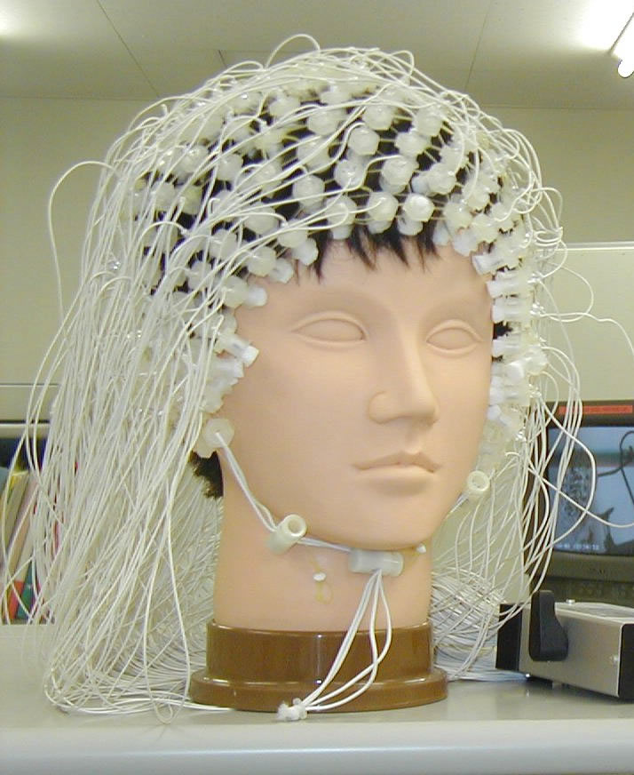
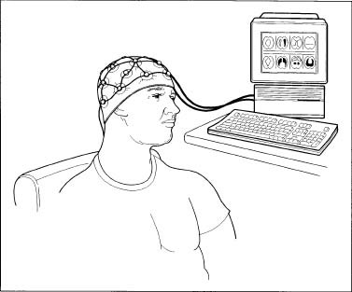
EEG
Notes:
Electroencephalography: Electrical currents are not measured, but rather voltage differences between different parts of the brain; high temporal resolution; similar to MEG

Slide 8
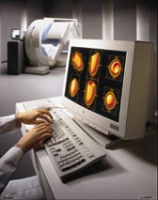
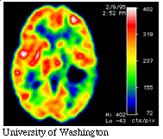
PET
Notes:
Positron emission tomography: injected with radioactive isotope; as decays releases 2 simultaneous gamma rays which are measured

Slide 9
Brain imaging
Comparison of people performing different tasks (experimental + control task) by observing the images of the regions of the brain that are differentially activated by the experimental task.
Electro-encephalogram (or EEG) uses electrodes attached to the scalp to measure electrical activity synchronized to stimulus events or behavioral responses known as Event Related Potentials, or ERPs
(poor spatial resolution but unobtrusiveness and portability)
Positron emission topography (PET) scanning measures blood flow in the brain, which is a reasonable proxy for neural activity, since neural activity in a region leads to increased blood flow to that region
(poor temporal resolution for stochastic lag of blood, i.e. flow)
Functional magnetic resonance imaging (fMRI), which tracks activity in the brain proxied by changes in blood oxygenation - neural processes are thought to occur on a 0.1 millimeter scale in 100 microseconds (msec)
(the spatial and temporal resolution of a typical scanner is only 3 millimeters and about two seconds)

Slide 10
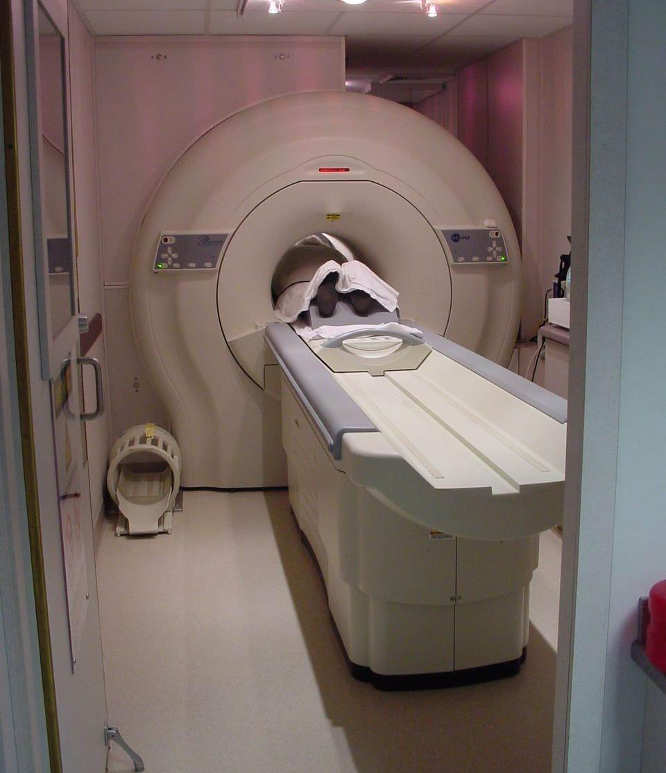
Functional Magnetic Resonance Imaging (fMRI)
Uses strong magnetic fields to create images of biological tissue
Measures hemodynamic signals related to neural activity
Blood Oxygenation Level Dependent (BOLD) contrast
MR signal of blood is dependent on level of oxygenation
Changes in deoxyhemoglobin
Blood flow in the brain implies function
Studies have shown regional brain activity when exposed to cues (Huettel et al. 2004)
Source: UC Irvine Center for Functional Onco-Imaging
Notes:
1.5T MR System: A Philips MR Imaging system dedicated to research with 27 mT/m whole-body gradients with 72 mT/m/sec slew rate is available for the proposed studies. The system has multi and single shot EPI imaging capability as well as the necessary software and hardware for proton spectroscopy. The system that is housed at the Center for Functional Onco-Imaging is used for human and animal research studies.
Tesla: unit of magnetic field; earth’s gravity = 0.00005

Slide 11
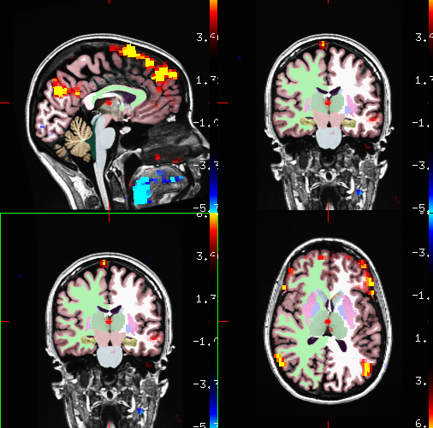
Why is fMRI so exciting?
Non-invasive
Better temporal resolution
Good and improving spatial resolution
Can be used in conjunction with other methods
Source: MGH/MIT/HMS Athinoula A. Martinos Center for Biomedical Imaging Visiting Fellowship Program in fMRI, 2005
Notes:
Galvanic skin response, behavioral

Slide 12
Basic facts about the brain
The brain is divided into two halves and each half is divided into four lobes: frontal, parietal, occipital and temporal
Regions of these lobes are interconnected and create specialized “circuits” for performing various tasks.
What do each of these lobes do?
Frontal Lobe - associated with reasoning, planning, parts of speech, movement, emotions, and problem solving
Parietal Lobe - associated with movement, orientation, recognition, perception of stimuli
Occipital Lobe - associated with visual processing
Temporal Lobe - associated with perception and recognition of auditory stimuli, memory, and speech

Slide 14
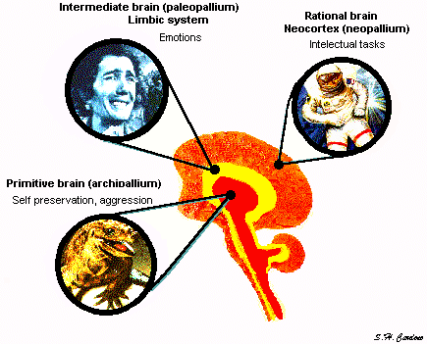
The human brain is a primate brain with more neocortex. The fact that many human and animal brain structures are shared means that human behavior generally involves interaction between “old” brain regions and more newly-evolved ones.

Slide 15
Triune division of brain
Paul MacLean (1990)
“reptilian brain,” which is responsible for basic survival functions, such as breathing, sleeping, eating
“mammalian brain,” which encompasses neural units associated with social emotions
“hominid” brain, which is unique to humans and includes much of our oversized cortex—the thin, folded, layer covering the brain that is responsible for such “higher” functions as language, consciousness and long-term planning

Slide 17
The “new” regions
Prefrontal cortex – the executive region because it draws inputs from almost all other regions and plan actions. The prefrontal area is the region that has grown the most in the course of human evolution and which, therefore, most sharply differentiates us from our closest primate relatives
The “old” regions
Limbic System as the main area involved with emotions
Amygdala play an important role on the mediation and control of major affective activities like friendship, love and affection, on the expression of mood and, mainly, on fear, rage and aggression. It is also the center for identification of danger
Hippocampus is particularly involved with memory phenomena, specially with the formation of long-term memory (the one that, sometimes, lasts forever).
Hypothalamus is involved in the so-called motivated behaviors, like thermal regulation, sexuality, combativeness, hunger and thirst. It is also believed to play a role in emotion.

Slide 18
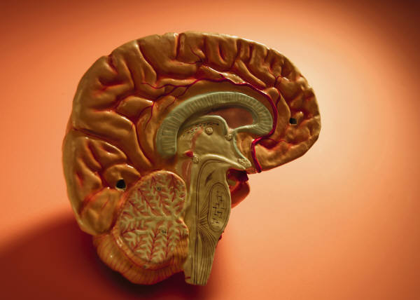
Limbic System
Thalamus
Cingulate Gyrus
Striatum
Hippocampal
Formation
Corpus
Callosum
Hypothalamus
Amygdala
Pons
Cerebellum
Spinal Cord
Notes:
Medial surface/Sagittal View
Amygdala: Lies in front of hippocampus in the anterior pole of the temporal lobe and is important in the control of emotional behavior.
Cerebellum: Prominent hindbrain structure that governs motor coordination, posture and balance.
Cingulate Gyrus: Lies just superior to corpus callosum and forms part of the limbic system; important in emotional functions.
Corpus Callosum: Large midline fiber structure that contains axons that connect the cortex on the two sides of the brain.
Hippocampal Formation: A cortical structure in the temporal lobe; important to a variety of functions including short term declarative memory.
Hypothalamus: Part of the diencephalon which integrates functions from the autonomic nervous system and controls endocrine hormone release of the pituitary gland; governs reproductive, homeostatic and circadian functions.
Insular Cortex (not shown): Part of the cerebral cortex found in the depths of the lateral fissure; important in taste, internal body senses and some aspects of pain.
Pons: Component of the brain stem which plays key role in eye movement
Spinal Cord: Portion of the central nervous system that extends from the lower end of the brainstem.
Striatum: Made up of the caudate and putamen and is part of the basal ganglia; involved in planning and modulation of movement but also involved in other cognitive processes including executive function and processing of reward, aversion, novel or unexpected stimuli.
Thalamus: A part of the diencephalons which is a key structure for transmitting sensory information to the cerebral hemispheres from the lower centers.
(Martin 2003; Purves et al. 1997)
Larry Cahill: emotions influence on memory
James McGaugh: learning and memory

Slide 19
 | Cognitive | Affective
Controlled Processes serial effortful evoked deliberately good introspective access | I | II
Automatic Processes parallel effortless reflexive no introspective access | III | IV
Quadrant I - deliberate whether to refinance your house, poring over present-value calculations (is the realm of economics)
Quadrant II - used by “method actors” who imagine previous emotional experiences to fool audiences into thinking they are experiencing those emotions
Quadrant III - governs the movement of your hand
Quadrant IV - makes you jump when somebody screws

Slide 20
Controlled processes
conscious and introspectively accessible
tend to be serial and to use a step-by-step logic
tend to be invoked deliberately by the agent when her or she encounters a challenge or surprise
are often associated with a subjective feeling of effort
Automatic processes
operate outside of conscious awareness
tend to operate in parallel
are often associated with a feeling of effort
people often have surprisingly little introspective access to automatic choices
Ex. a face is perceived as ‘attractive’, or a verbal remark as ‘sarcastic’, automatically and effortlessly
Cognitive processes
those that answer true/false questions
to influence behavior the cognitive system must operate via the affective system
Affective processes
those that motivate approach/avoidance behavior.
include emotions such as anger, sadness, and shame, as well as "biological affects" such as hunger, pain, and the sex drive.

Slide 21
Automatic processes
Key principles
Parallelism much of the brain's processing involves processes that unfold in parallel and are not accessible to consciousness
Plasticity the brain undergoes physical changes as a result of these processes: when signals are repeatedly conveyed from one neuron to another, the connections between those neurons strengthen (Hebb 1949) . Information processing is unlikely to be reversible because the physiological processes that produce learning are themselves not reversible
Modularity it draws upon multiple modules specialized to perform specific functions neurons in different parts of the brain have different shapes, structures and functions
Specialization when the brain is confronted with a new problem it initially draws heavily on diverse modules, including, often, the prefrontal cortex, but over time, activity becomes more concentrated in modules that specialized in processing relevant to the task

Slide 22
Affective processes
Key Principles
Homeostasis Affective system involves detectors that monitor when a system departs from a 'set-point' and mechanisms that restore equilibrium when such departures are detected (it is highly attuned to changes in stimuli rather than their levels). Some of these mechanisms do not involve deliberate action
Raw motivation Economists usually view behaviour as a search for pleasure . Neuroscience and other areas of psychology show that the motivation to take an action is not always closely tied to hedonic consequences (liking vs. wanting systems)
Competition Affective system often plays as if the decision maker is of "two minds“. It drive us in one direction and cognitive deliberations in another
Erroneous sense-making Since quadrant I often does not have conscious access to behavior in the other quadrants, it is often tends to over attribute behavior to itself, i.e. to a deliberative decision process.

Slide 23
MAIN FINDINGS
Decision making is not a unitary process—a simple matter of integrated and coherent maximization—because it is driven by the interaction between automatic and controlled processes.
The extent to which intertemporal choice is generated by multiple systems with conflicting priorities is consequently the most debated issue within neuroeconomics. Most evidence favors a multiple systems perspective.
Neuroeconomic research on social preferences is supportive of a dual-systems account, also with regard to how self-interest and fairness concerns interact to influence behavior
Economics is intertwined with o psychology by inspiring economic models increasingly grounded in psychological reality and by addressing debates on if multiple systems operate sequentially or in parallel to influence behavior

Slide 24
implications for economics (1)
Neuroscience raises questions about the usefulness of some of the most common constructs that economists commonly use, such as risk aversion, time preference, and altruism.
These characteristics are considered as stable over time and consistent across activities
Neuroeconomics shows that they are weakly correlated or uncorrelated across situations
Inconsistency derives from state-contingent preferences
Intertemporal preferences are assumed to be constant for different types of investment
The modularity of the brain implies that different types of intertemporal choices activate different mixtures of neural system (cigarette, dieting, saving, being on time) and different choices

Slide 25
implications for economics (2)
The existence of specialized systems challenges standard assumptions about human information processing and suggests that intelligence and its opposite—bounded rationality—are likely to be highly domain specific.
Brain is composed by systems evolving to perform specific functions. Our problem-solving capacity (Wason’s task) depends on be tailored to do certain tasks
Brain modules are highly specialized, such as mirror neurons or theory of mind, i.e. there is a module controlling a person’s inference about what other people believe, feel or might do
Mentalizing is a special ability and logical deductive reasoning can only partially compensate for its absence
Organization of labor: bundling tasks together into jobs requires un understanding of which kind of skills are general and which are neurally separate

Slide 26
implications for economics (3)
Brain-scans conducted while people win or lose money suggest that money activates similar reward areas as do other “primary reinforcers” like food and drugs, which implies that money confers direct utility, rather than simply being valued only for what it can buy.
The same dopaminergic reward circuitry of the barin (mesolimbic system) is activated for various reinforcers, such as cocaine, attractive faces, sport cars, jokes and money as well
Money provides direct reinforcement: people value money without carefully computing what they plan to buy wit it
If gaining money provides direct pleasure, then the experience of parting with it its probably painful
Excessive use of credit cards
To oversubscribe flat-rate payment plans for telephone service or health clubs, which eliminate marginal costs and allows to enjoy the service without thinking about the marginal cost

Slide 27
implications for economics (4)
Research on the motivational and pleasure systems of the brain human challenges the assumed connection between motivation and pleasure, wanting and liking.
For economists behavior is search for pleasure: to give people what they want makes them better off
This assumption depends on knowing that people will like what they want. If likes and wants diverge, this would pose a fundamental challenge to standard welfare economics
Neuroscience shows that to take an action is not always closely tied to hedonic consequences and decision-making involves the interaction of two separate overlapping systems, one responsible for pleasure and pain (the liking system) and the other for motivation (the wanting system)
In later stages of drug addictions there is wanting without liking for the disconnection between the two systems
Presumably welfare should be based on “liking.” But if we cannot infer what people like from what they want and choose, then an alternative method for measuring liking is needed, while avoiding an oppressive paternalism

Slide 28
implications for economics (5)
Important implications of cognitive inaccessibility for economic decision-making
The lack of introspective access make people unable to correct discriminatory biases on job markets
To acknowledge the effect of gifts from pharmaceutical companies on physician’s prescriptions
Investors, consumers, entrepreneurs are overly optimistic about their chances for success and this is related to chronic cognitive inaccessibility of automatic brain processes
Confirmation bias

Slide 29
A critique of neuroeconomics
(Harrison 2008)
The heavy use of localization assumptions
when it is asserted that such-and-such a part of the brain lights up in relation to a particular stimulus, this conclusion is arrived at by subtraction. Much more of the brain is already busy or lit up. All the scientist can observe is the additional activity associated with the stimulus. Minor changes noted diffusely are overlooked.
the additional activity can be identified only by a process of averaging the results of subtractions after the stimulus has been given repeatedly: variations in the response to successive stimuli are ironed out.
experiments look at the response to very simple stimuli – for example, a picture of the face of a loved one compared with that of the face of one who is not loved. But love is not like a response to a stimulus because it encompasses many more things

Slide 30
A critique of neuroeconomics
(Harrison 2008)
The reverse inference problem
The usual kind of inference that is drawn from brain imaging is ‘if cognitive process X is engaged, then brain area Z is active.
(1) In the present study, when task comparison A was presented, brain area Z was active.
(2) In other studies, when cognitive process X was putatively engaged, then brain area Z was active.
(3) Thus, the activity of area Z in the present study demonstrates engagement of cognitive process X by task comparison A.
This is a ‘reverse inference’, in that it reasons backwards from the presence of brain activation to the engagement of a particular cognitive function.
It is self-evidently not a matter of deductive logic, and indeed in introductory philosophy classes it is presented as the formal fallacy of “affirming the consequent”

