Slide 1
Course Behavioral Economics Alessandro Innocenti
Academic year 2013-2014
Lecture 2 Experiments and Virtual Reality
Lecture 2 experiments and Virtual reality
Aim: To provide a basic introduction to experimentation in virtual reality and virtual worlds.
Outline: Discussion of the results of the experiment run in Lecture 1. Internal and external validity. Virtual reality and experiments.
Readings:
Bainbridge, W. S. (2007). “The scientific research potential of virtual worlds.” Science 317, 472–476.
Harrison, G. W., E. Haruvy, and E. E. Rutström. (2011) “Remarks on Virtual World and Virtual Reality Experiments.” Southern Economic Journal 78, 87–94.
Rosenberg R.S., S. L. Baughman S.L., and J. N. Bailenson (2013) “Virtual Superheroes: Using Superpowers in Virtual Reality to Encourage Prosocial Behavior.” PLoS ONE 8(1).
Blogs, Videos and Websites:
Laboratory of Virtual Reality and Economic Behavior
http://www.lavreb.unisi.it/

Slide 2
VIRTUAL EXPERIMENTS
Lecture 2 Experiments and Virtual Reality
Many experimental economists seem to view their enterprise as akin to silicon chip production. Subjects are removed from all familiar contextual cues. Like the characters 'thing one' and 'thing two' in Dr. Suess' Cat in the Hat, buyers and sellers become 'persons A and B', and all other information that might make the situation familiar and provide a clue about how to behave is removed.
George Loewenstein (1999)

Slide 3
Trust Game

Slide 4
The context free experiment
Lecture 2 Experiments and Virtual Reality
The context-free experiment is an elusive goal and not necessarily a good thing
Games in the laboratory are usually played without labels but subjects inevitably apply their own labels
A major discovery of cognitive psychology is how all forms of thinking and problem solving are context-dependent (language comprehension)
The laboratory is not a socially neutral context, but is itself an institution with its own formal or informal, explicit or tacit, rules

Slide 5
Internal vs. External Validity
Lecture 2 Experiments and Virtual Reality
Internal validity - ability to draw confident causal conclusions from one's research
External validity - ability to generalise from the research context to the settings that the research is intended to approximate
Experiments have the reputation of being high in internal validity but low in external validity
Field studies of being low in internal validity but high in external validity

Slide 6
Methodological Biases
Lecture 2 Experiments and Virtual Reality
One of the basic tenets of laboratory methodology is that the use of non-professional subjects and monetary incentives allows making subjects’ innate characteristics largely irrelevant
In some experiments, it is as if subjects take into the lab the preferences applied to real choices and stick to them with high probability
These biases or inclinations tend to override the incentives effect
Labels may give subjects clues to become less and not more rational

Slide 7
The power of labels
Lecture 2 Experiments and Virtual Reality
Subjects’ behavior depends more on prior learning outside the laboratory than on expected gains in the laboratory
Labels have the power to increase external validity with a minimal sacrifice of the internal validity
To test learning and cognitive models, it is necessary to remind and to evoke contexts which may activate emotions, association, similarities in the laboratory
The use of presentations with virtual reality (VR) visualisations can convey objectively this kind of information
A Virtual Experiment combines insights from virtual reality (VR) simulations in computer science, naturalistic decision making (NDM) and ecological rationality from psychology, and field and lab experiments from economics

Slide 8
Virtual Experiments
Lecture 2 Experiments and Virtual Reality
The methodological objective of Virtual Experiments is to combine the strengths of the artificial controls of laboratory experiments with the naturalistic domain of field experiments or direct field studies
In a virtual experiment the internal validity of controlled lab experiments is joined with the external validity of field experiments

Slide 9
Head Mounted Display

Slide 10
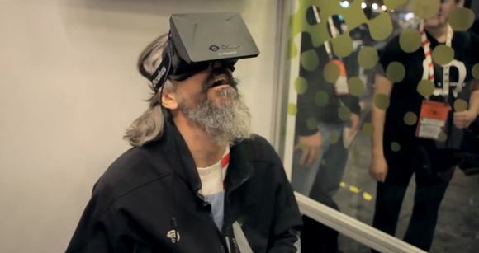
Oculus Rift

Slide 11
Tuscany Demo Oculus

Slide 12
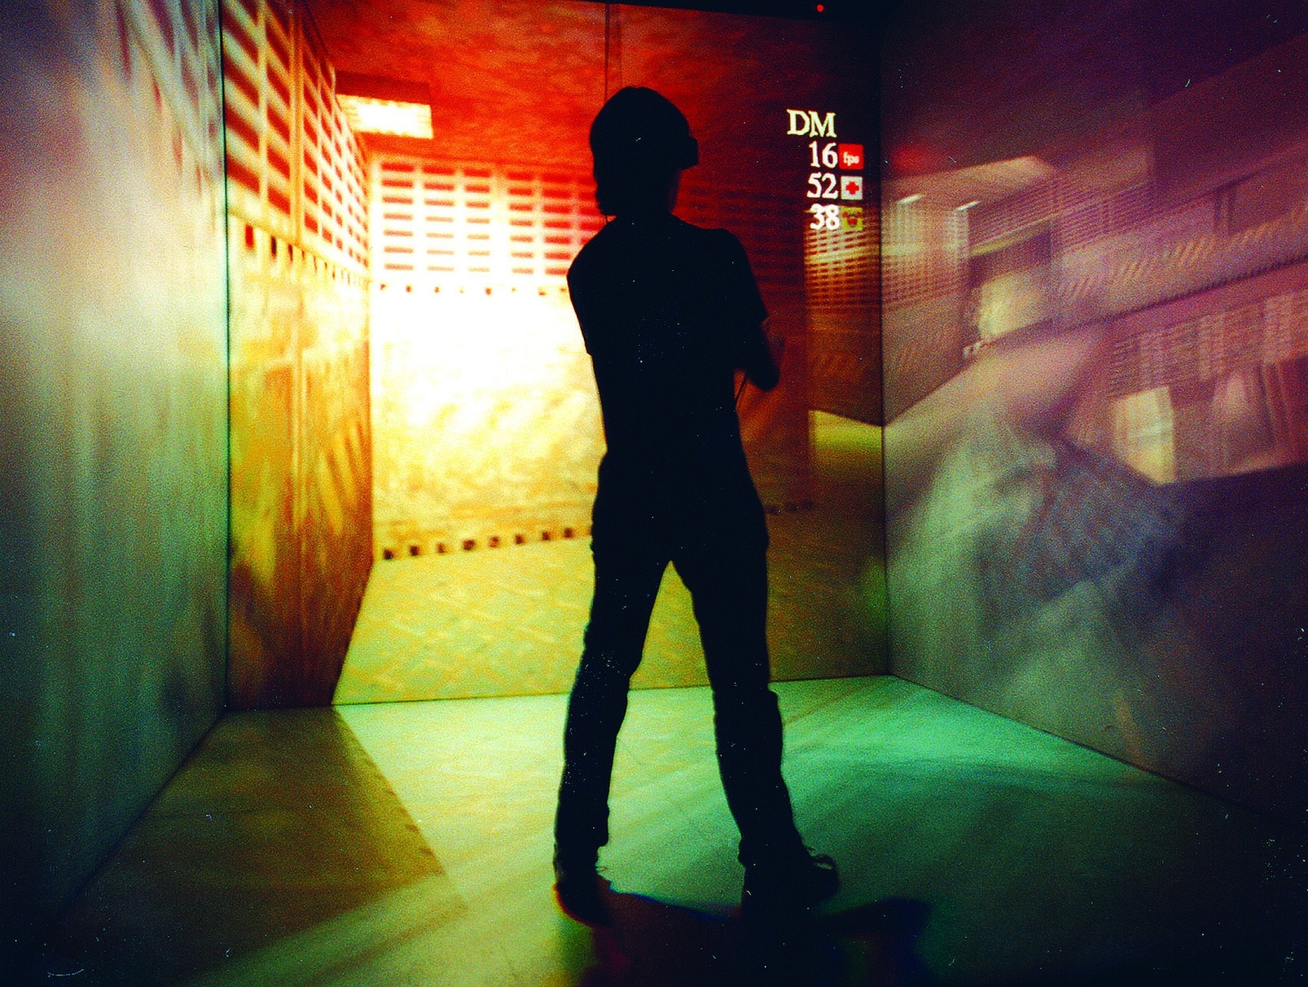
Cave

Slide 13
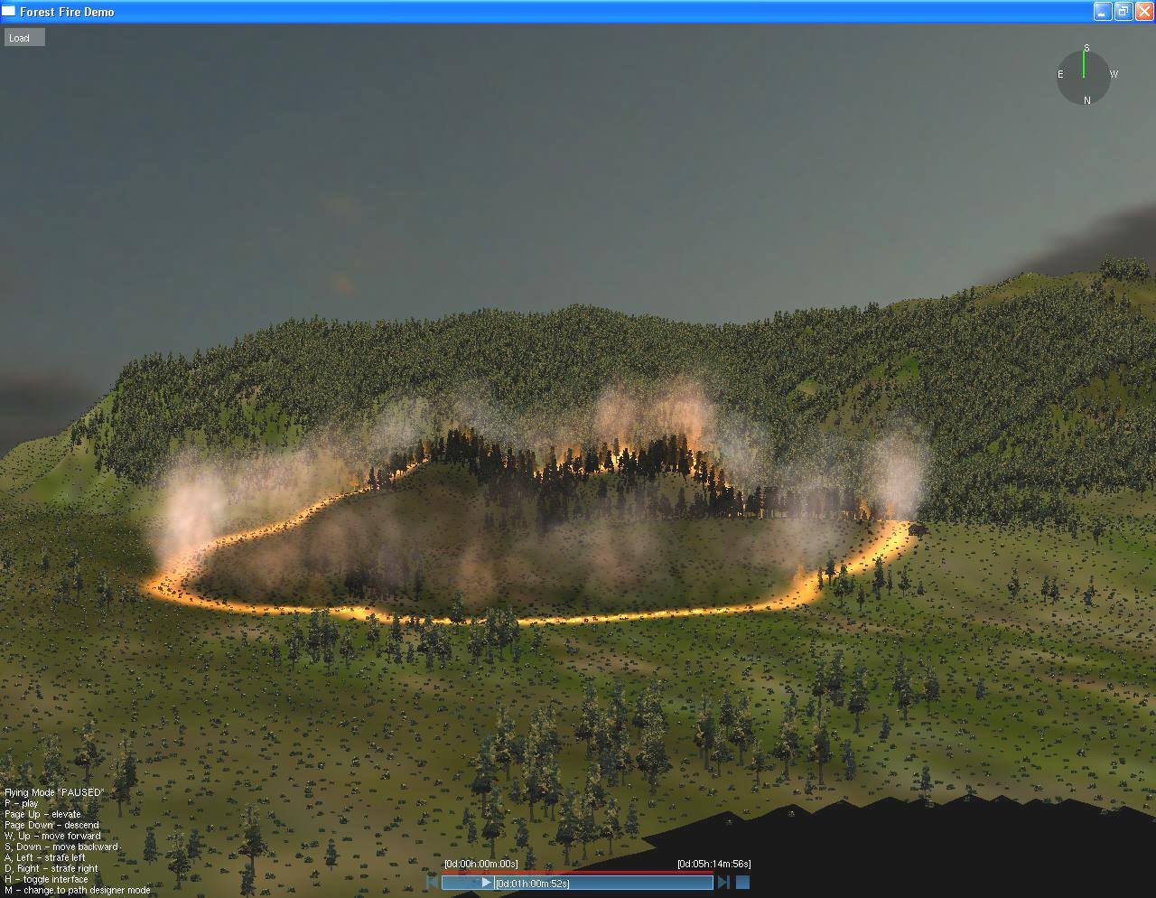
Virtual Simulations

Slide 14
Applications - ALBO Project

Slide 15
Applications – Risk Perception
Lecture 2 Experiments and Virtual Reality
Fiore et al. 2009
Virtual Experiment to elicit subjective risk perception from wild fires and the opportunity cost of public funds allocated to prescribed burns
Subjects experience four dynamic visual simulations of specific wild fires, with varying weather and fuel conditions. Simulations are selected to represent high and low risk of fire damage
Participants experience a sense of presence, a psychological state of “being there and take decisions closer to real behavior (with cognitive constraints )

Slide 16
Applications – Risk Perception

Slide 17
Lecture 2 Experiments and Virtual Reality
Applications- Virtual Superheroes
to Encourage Prosocial Behavior
http://www.youtube.com/watch?v=wnQgDsdy7zg
Background
Playing prosocial video games leads to greater subsequent prosocial behavior in the real world.
Thesis
In immersive virtual reality occupying an avatar with the superhero ability to fly increases helping behavior.
Methods
(two-by-two design) participants were either given the power of flight and were assigned one of two tasks, either to help find a missing diabetic child in need of insulin or to tour a virtual city.
Findings
The results indicate that having the “superpower” of flight leads to greater helping behavior in the real world

Slide 18
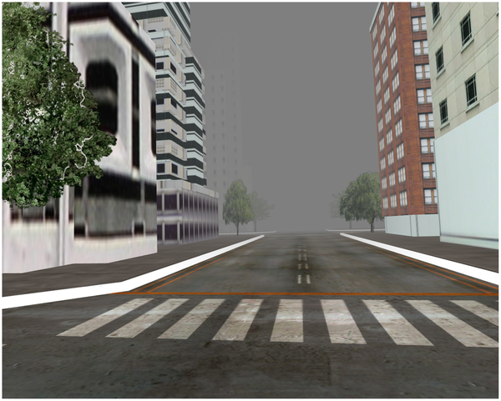
Figure 2. Foggy virtual city.
Rosenberg RS, Baughman SL, Bailenson JN (2013) Virtual Superheroes: Using Superpowers in Virtual Reality to Encourage Prosocial Behavior. PLoS ONE 8(1): e55003. doi:10.1371/journal.pone.0055003
http://www.plosone.org/article/info:doi/10.1371/journal.pone.0055003

Slide 19
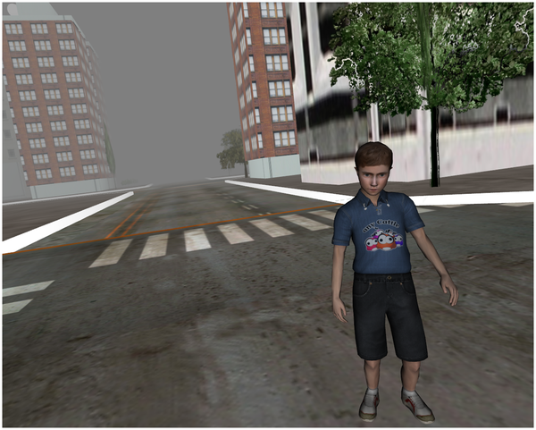
Figure 3. Virtual Child After Being Found and Saved.
Rosenberg RS, Baughman SL, Bailenson JN (2013) Virtual Superheroes: Using Superpowers in Virtual Reality to Encourage Prosocial Behavior. PLoS ONE 8(1): e55003. doi:10.1371/journal.pone.0055003
http://www.plosone.org/article/info:doi/10.1371/journal.pone.0055003

