Slide 1

Course Behavioral Economics Alessandro Innocenti
Academic year 2013-2014
Lecture 12 Intertemporal choice
Lecture 12 Intertemporal Choice
Aim: To analyze behavioral theories of intertemporal choice.
Outline: Time inconsistency. Magnitude and sign effect. Reference point. Quasi-hyperbolic discounting. Dual neural system.
Readings:
Lowenstein, G. and R. H. Thaler (1989) “Anomalies: Intertemporal Choice”, Journal of Economic Perspectives, 3, 181-193.
Laibson, D. (1997) “Golden Eggs and Hyperbolic Discounting”, Quarterly Journal of Economics, 112, 433-478.
McClure, S. M., D. L. Laibson, G. Loewenstein. and J. D. Cohen (2004) “Separate neural systems value immediate and delayed monetary rewards”, Science, 306, 503-507.
Blogs, Videos and Websites
Procrastination. “You are not so smart” Blog
http://youarenotsosmart.com/2010/10/27/procrastination/

Slide 2
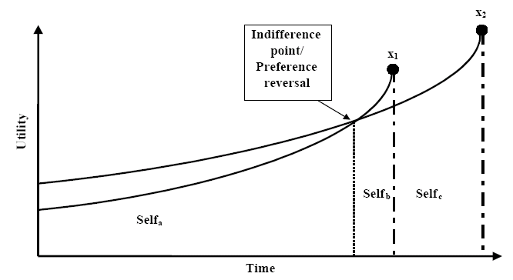
TIME INCONSISTENCY
Choice between x1 (smaller) and x2 (larger) (t2 > t1)
lines/present utility of x
If the individual discount x at a constant rate, curves do not cross
When rewards are distant, x2 pref. x1 but as x1 becomes more proximate preference changes

Slide 3
MAgniTuDE and sign EFFECT
Magnitude effect
The implicit discount rates declined sharply with the size of purchase
The perceptual difference between 100$ now and 150$ in a year appears greater than the difference between 10$ now and 15$ in a year
People waits for the extra 50$ in the first case but not for the $5 in the second
Sign effect
Discount rates for gains is much greater than for losses
People are quite anxious to receive a positive reward but are less anxious to postpone a loss

Slide 4
REFERENCE POINT
Decision makers do not integrate outcomes with their existing wealth or consumption but react to events as changes, relative to some reference point
Loewenstein and Prelec (1989)’s French and Greek restaurant experiment
1 Two free dinners to be consumed in one month
French vs Greek dinner
2. French dinner in one or French dinner in two months
3. Greek in one month and French in two months or French in one month and Greek in two months
Subjects exhibit a negative time of rate preference
People evaluate current consumption relative to past consumption and are loss averse
They prefer a pattern of increasing utility over time

Slide 5
COMMITMENT
David Laibson “Golden Eggs and Hyperbolic Discounting” (1997)
“Use whatever means possible to remove a set amount of money
from your bank account each month before you have a chance to
spend it” —advice in New York Times “Your Money” column [1993].
“Many people place a premium on the attribute of self-control. Individuals who have this capacity are able to stay on diets, carry through exercise regimens, show up to work on time, and live within their means. Self-control is so desirable that most of us complain that we do not have enough of it. Fortunately, there are ways to compensate for this shortfall. One of the most widely used techniques is commitment. For example, signing up to give a seminar is an easy way to commit oneself to write a paper. Such commitments matter since they create constraints (e.g., deadlines) that generally end up being binding”

Slide 6
QUASI-HYPERBOLIC DISCOUNT
Function inducing dynamically inconsistent preferences, implying a motive for consumers to constrain their own future choices.
Many people place a premium on attribute of self-control, but even for those who lack it precommitment may do the trick
Decision-makers foresees these conflicts and uses a stylized commitment technology to partially limit the options available in the future.
Laibson models the individual to choose between an liquid asset and a partially illiquid (money can only be accessed a period after the decision about deinvesting was made).
Empirical approach: by using credit card data from the 1980s, his theoretical framework is fully supported.
The model provides a formal framework for considering the proposition that financial market innovation reduces net welfare by providing “too much” liquidity.

Slide 7
PREDICTIONS
The model explains why consumers have a different propensity to consume out of wealth than they do out of labor income as wealth is invested (partly illiquid).
The model suggests that financial innovation (esp. credit cards) may have caused the ongoing decline in U. S. savings rates
Financial innovation increases liquidity and eliminates implicit commitment opportunities such as investing in illiquid assets as the way to store wealth
This paper was written before the introduction of subprime mortgages and compared to the savings rate in the paper, the trend of declining savings rates has not been changed.

Slide 8
Dual neural systems
McClure et al.’s (2004) experiment with functional magnetic resonance imaging (fmri)
Neural correlates of time discounting while subjects made a series of choices between monetary reward options that varied by delay to delivery (either now-future or future-future)
Subjects made a series of choices between small proximal rewards and larger delayed rewards
(ex. $5 now or $10 in 2 weeks)
In some trials the proximal reward was available immediately, and in other trials participants chose between two delayed rewards

Slide 9
McCLURE et al.’s findings
1. Limbic and paralimbic cortical (dopaminergic)
ventral striatum (VStr)
medial prefrontal cortex (MPFC)
medial orbital frontal cortex (MOFC)
posterior cingulated cortex (PCC)
were significantly more active in trials involving an immediate reward than in trials where both rewards were delayed.
2. fronto-parietal regions (cognitive functions)
the right dorsolateral prefrontal cortex (DLPFC)
were activated about equally for both types of decisions.
3. when decisions involved an immediate reward, greater activity in fronto-parietal regions than in limbic regions predicted the selection of larger, delayed rewards

Slide 10
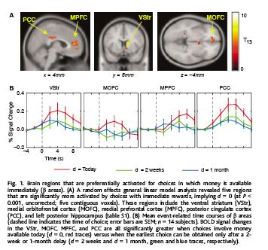
dopaminergic REGIONS
1

Slide 11
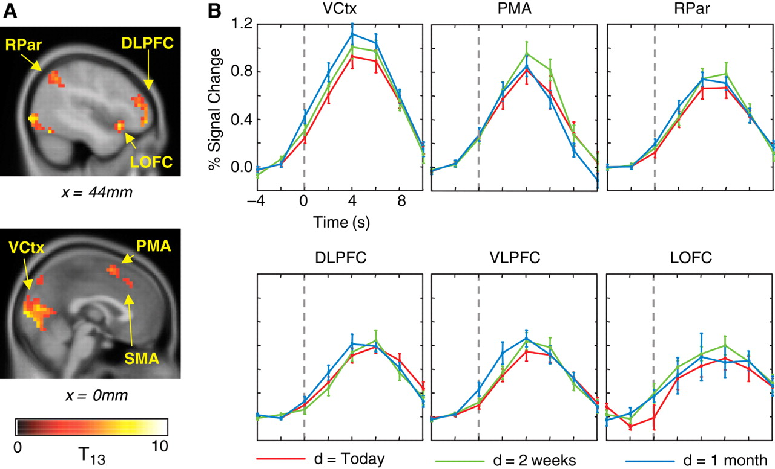
COGNITIVE REGIONS
1

Slide 12
APPLICATIONS
heroin addicts temporally discount not only heroin but also money more steeply in a drug-craving state (immediately before receiving treatment with methadon) than when they are not in a drug-craving state (immediately after treatment)
human behavior is governed by a competition between automatic processes reflecting evolutionary adaptations to particular environments, and the more recently evolved, uniquely human capacity for abstract, domain-general reasoning and future planning.

Slide 13
Quasi - Hyperbolic discounting
Data confirm Laibson's (1997) beta–delta model of quasi hyperbolic discounting: when the patient delta (fronto-parietal) regions exerted greater influence than the impulsive beta (limbic) regions, participants tended to select the larger, delayed reward.
This explains why many factors other than temporal proximity, such as the sight or smell or touch of a desired object, are associated with impulsive behavior.
If impatient behavior is driven by limbic activation, it follows that any factor that produces such activation may have effects similar to that of immediacy.

Slide 14
OTHER THEORIES OF INTERTEMPORAL CHOICE
  Visceral influence models: anger, lust, hunger, sleeplessness change the future utility of choices and discounting behaviour
  Emotion-based theories. Temporal and physical proximity of options leads to a disproportionate but transient increase in attractiveness of options. Arousal not caused by delay but by aggravating stimulus
Projection bias: no rational expectations - weighting function indicating how accurate people are able to forecast future utility from choices
  Habit-formation models: consumption depends on past peak of consumption - the higher past consumption, the more consumption today
Mental accounting models: different discount rates for different goods, e.g. small payoffs labeled as "petty cash" and discounted differently than "money"
Dual-Self-Model: far-sighted self is the principal or planner, the short-term self is the "doer" or agent. - commitment, gambling with pocket cash but not with high stakes even if odds are identical

