Slide 1

Course Behavioral Economics Alessandro Innocenti
Academic year 2013-2014
Lecture 10 Prospect theory
Lecture 10 Prospect theory
Aim: To analyze Kahneman and Tversky’s prospect theory and its implications.
Outline: Conceptions of rationality. Models of man. Experimental evidence against the standard utility function. Prospect theory. Loss aversion.
Readings:
Kahneman, D. (2011) Thinking, Fast and Slow, Farrar, Straus and Giroux, New York, chapt. 25-26.
Kahneman, D. and A. Tversky (1979), “Prospect Theory: An Analysis of Decision Under Risk”, Econometrica, 47 (2), 263-291.
Blogs, Videos and Websites
Prospect theory. Clip from How to Make Better Decisions – BBC (3:11)
http://www.youtube.com/watch?v=my_oVMDRklM

Slide 2
Conceptions of rationality
What do we mean by rational choice? Lots of formulations, involving assumptions of different strength
Different forms of rationality imply different experiments to test them
Goal oriented
Satisficing behavior
Maximizing behavior
Ordinal utility maximization
Expected utility maximization
Subjective expected utility maximization
Experimental economics reveals the hidden or implicit assumption by showing anomalies in the formulation of rationality
Consequence: there is a variety of definitions of rational individual. And what about heterogeneity?

Slide 3
MODELS OF MAN
Risk neutral economic man: never buys insurance, but would be willing to pay any finite amount to participate in Petersburg paradox.
Expected utility maximizing man: buys insurance, but ignores sunk costs, and is immune to framing effects.
Almost rational economic man (e.g. prospect theory man) has malleable reference points and probability perceptions, but still has preferences - comfortable with non-utility Allais choices, but doesn’t exhibit preference reversals.
Psychological man doesn’t have preferences, has mental processes. Different frames and contexts, and different choice procedures elicit different processes - So he may sometimes exhibit preference reversals because choosing and pricing elicit different mental procedures.
Neurobiological man: doesn't (even) have a fixed collection of mental processes, in the sense of psychological man. He has biological and chemical processes which influence his behavior. Different blood chemistry leads to different mental processes; e.g. depending on the level of lithium (or Valium or Prozac) in his blood, he makes different decisions (on both routine matters and matters of great consequence - even life and death).

Slide 4
EXPERIMENTS WITHIN SUBJECTS
Experiment 1
Which of the following options do you prefer?
A. A sure win of $30
B. An 80% chance to win $45
Which of the following options do you prefer?
C. A 25% chance to win $30
D. A 20% chance to win $45

Slide 5
EXPERIMENTS WITHIN SUBJECTS
[Tversky and Kahneman 1981, Thaler 1980]
Experiment 1
(certainty effect)
Which of the following options do you prefer?
A. A sure win of $30 [78%] EV 30
B. An 80% chance to win $45 [22%] EV 36
Which of the following options do you prefer?
C. A 25% chance to win $30 [42%] EV 7.5
D. A 20% chance to win $45 [58%] EV 9
0,20×U(45) > 0,25×U(30) ⇒ U(45 )/U(30) > 0,25/0,20
0,80×U(45) < 1×U(30) ⇒ U(45 )/U(30) < 1/0,80
but 0,25/0,20 = 1/0,80

Slide 6
Experiment 2
Imagine that you face the following pair of concurrent decisions. First examine both decisions; then indicate the options you prefer:
Decision (i). Choose between
A. Sure gain of $240
B. 25% chance to gain $1,000 and 75% chance to lose nothing
Decision (ii). Choose between
C. A sure loss of $750
D. 75% chance to lose $1,000 and 25% chance to lose nothing
Experiment 3
Choose between
E. 25% chance to win $240 and 75% chance to lose $760
F. 25% chance to win $250 and 75% chance to lose $750

Slide 7
Experiment 2
(loss aversion)
Imagine that you face the following pair of concurrent decisions. First examine both decisions; then indicate the options you prefer:
Decision (i). Choose between
A. Sure gain of $240 [84%] EV +240
B. 25% chance to gain $1,000 and 75% chance to lose nothing [16%] EV +250
Decision (ii). Choose between
C. A sure loss of $750 [13%] EV -750
D. 75% chance to lose $1,000 and 25% chance to lose nothing [87%] EV -750
Experiment 3
(mental accounting)
Choose between
E. 25% chance to win $240 and 75% chance to lose $760 [0%]
EV -510
F. 25% chance to win $250 and 75% chance to lose $750 [100%]
EV -500
But E = A&D and F = B&C

Slide 8
CONSTRUCTIVE REACTIONS

Slide 9
PROSPECT THEORY
Experimental evidence
a) people perceive the outcome of a monetary prospect in terms of the variations (positive or negative) related to a non-constant reference level (usually the status quo) rather than in terms of absolute levels of wealth
b) people appear to be more adverse to losses, relatively to their reference level, than how they are attracted by the winning of the same value. The disutility of the monetary loss x is lower than the utility of winning the same amount x. Consequently, reaction to losses is stronger than the reaction to winnings.
Prospect Theory postulates the existence of two functions
the value function v
the weight function (or decisions weights) p - such as the decision maker strictly prefers X a Y iff
where x_{i} = x_{i} – x₀ is the variation associated to a prospect x_{i} with respect to a reference point x₀.

Slide 10
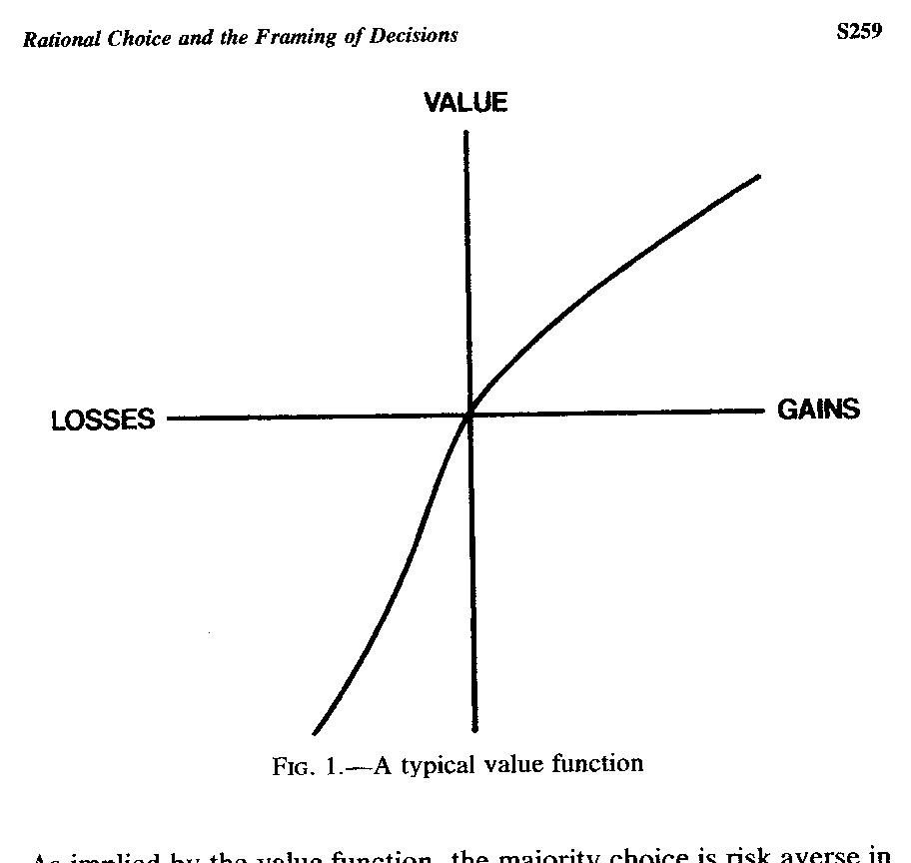

Slide 11
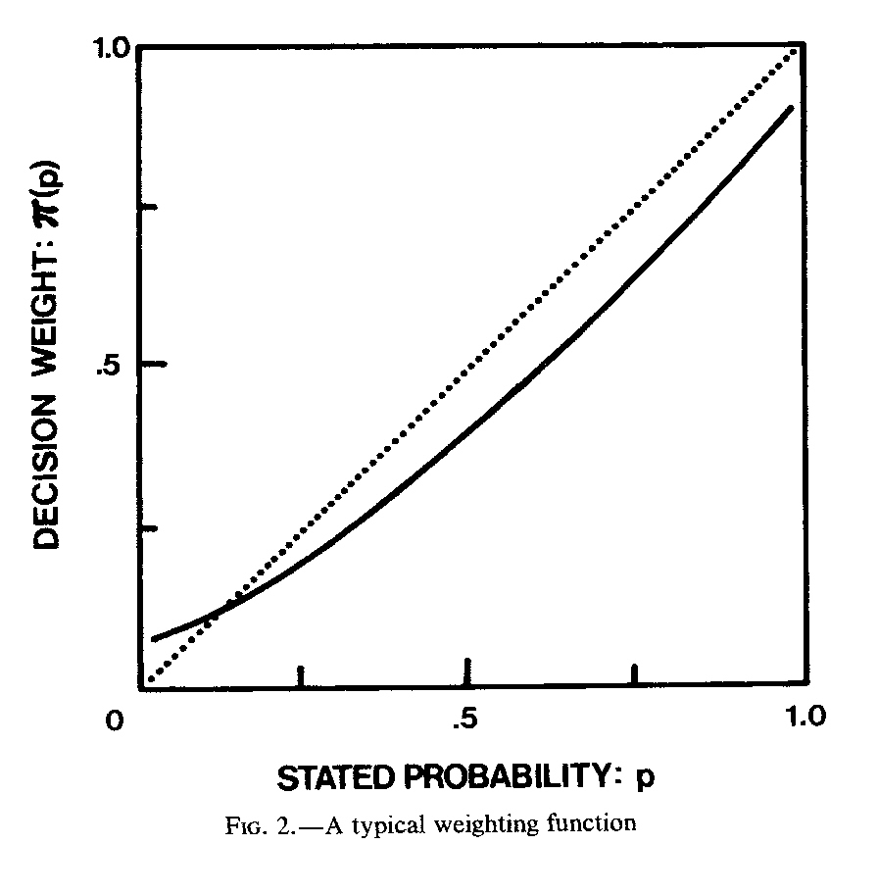

Slide 12
Prospect theory (PT)
vs.
subjective expected utility theory (SUET)
1) the decision maker is not interested in the final status per sé (SUET) but at the change of status ( x_{i}) with regard to the reference point (x₀) (PT)
2) the value function v is concave (“risk averse”) for gains and convex (“risk seeking”) for losses (PT).
3) the value function v is steeper around the reference point for losses than for gains (“loss aversion”).

Slide 13
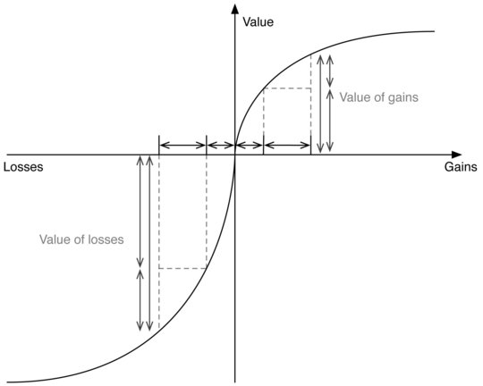
LOSS AVERSION

Slide 14
Prospect theory (PT)
vs.
subjective expected utility theory (SUET)
4) the psychological sensitivity to losses and gains diminishes marginally: incremental winnings/losses give decreasing marginal utility/disutility
5) while in SUET the utility of any possible event is weighted with his probability, in PT the value of any welfare change is multiplied by a “decision weight”, that is not a probability but a probability transformation. Probability transformations do not follow probability rules and cannot be interpreted as degree of beliefs. They are obtained by choices and measure the impact of events on prospects’ desirability and not the perceived probability of events.
6) the weight function p is monotone, increasing, and discontinuous between 0 and 1, because it sistematically overweights very low probabilities and underweights medium and high probabilities (“certainty effect”)

Slide 15
Loss aversion and DUAL SYSTEM
System 1 is pleased by gains, and upset by losses, and it is more upset by a loss than it is pleased by a gain of the same amount.
Cutting our losses in investment is generally choice-worthy because it avoids bigger losses in the long run—entails actualizing a loss in the moment
This is made difficult by system 1. “the thought of accepting the large sure loss is too painful, and the hope of complete relief too enticing, to make the sensible decision that it is time to cut one’s losses”.
One common manifestation of this phenomenon is the temptation to hang on to a losing stock—which temptation is especially strong when there is a decision to be made between selling a loser or selling a winner. For selling a losing stock means actualizing a loss, while selling a winner means actualizing a gain, and for System 1 there is a clear tendency to side with the latter over the former
“finance research has documented a massive preference for selling winners rather than losers—a bias that has been given an opaque label: the disposition effect” (loc. 6333).
Selling winners rather than losers is a significant error for two reasons
1. winning stocks tend to outperform losers (“at least for a short while”), and the net effect is significant (loc. 6349).
2. actualizing a loss reduces your taxes, while actualizing a gain increases them
3. Indeed, the one month of the year when the disposition effect is eliminated is December, when investors have taxes on the brain but “the tax advantage is available all year.”

Slide 16
Loss aversion and BARGAINING
Loss aversion also comes into play in many types of negotiations, and especially “renegotiations of an existing contract, the typical situation in labor negotiations and in international discussions of trade or arms limitations”.
In these situations, any given change in the pre-existing terms is likely to be seen by one of the sides as a concession to the other.
Since losses are felt more keenly than gains, the side that stands to lose on any new measure will fight harder against it than the other side fights for it.
This makes it very difficult to establish any changes.
And things get particularly dicey in cases where the circumstances require all parties to take a hit: “negotiations over a shrinking pie are especially difficult, because they require an allocation of losses. People tend to be much more easygoing when they bargain over an expanding pie”

Slide 17
Loss aversion and stocks
Why do some stocks consistently have lower returns than others? For example, stocks that experience an initial public offering (IPO) have lower returns than those that do not.
Capital Asset Pricing Model (CAPM) says that riskier investments—those with higher volatility than the market—should have a higher rate of return but this is not the case.
Prospect theory argues that stocks with the lowest returns are those with the highest positive skewness, which is found if a stock has many years of average returns, punctuated by the occasional high return.
If a stock has positive skewness, investors are entranced by the chance—even the very smallest chance—of becoming very wealthy. They reckon that an occasional good performance could be turned into a very occasional stunning performance.
It almost definitely will not be, but investors are poor at assessing future probabilities. Due to this poor “probability weighting”, investors overweight the unlikely state of the world in which they make a lot of money.

Slide 18
Loss aversion and bonds
The longstanding difference between the rate of return of stock market and government bonds is a consolidated finding in behavioral finance
On average, the rate of return for government bonds was around 6 percentage points lower than that for stocks, which is not explained by consumption-based models of asset prices and expected utility theory.
Investors find the idea of losing more painful than they find the idea of winning pleasurable.
So when they look at the high distribution of returns in the stock market, they are scared.
Buying stocks could lead to losses, and they would find this very difficult.
By contrast, bonds do not have a high distribution of returns. Investors feel safe. As a result, due to “loss aversion”, investors demand higher average return from stocks than bills.

